Slide 1
Future of Finance
Sushil Khanna

Slide 2
Past of Finance
We now know that Financial System no Longer serves need of production (Real economy)
Only 3 per cent of the UK’s £ 6 trillion ( £200 bn) Financial sectors assets constitute lending to business (manufacturing, retail, transport etc)
Consumer loans & mortgages = £ 1000 bn
Rest is all financial assets
What role this financial entities lending to each other mean for the economy??
Reforms to “ring fence” core banking (Vickers Comm) ??????

Slide 3
Past of Finance
Financial “Innovation” and “products” created new markets, which were supposed to reduce risk, reduce intermediation cost, and improve efficiency
With efficiency – intermediation costs should decline!!
But the profits of the financial sector rose to astronomical levels.

Slide 4
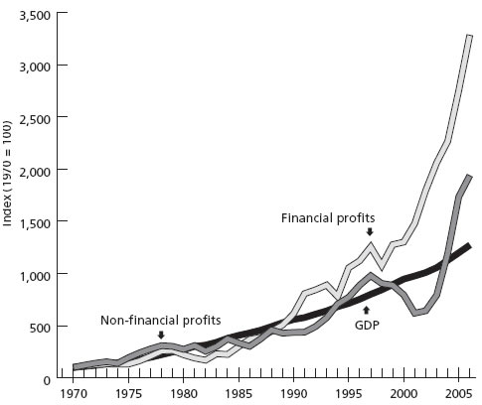

Slide 5
Question
Where do these profits come from?
In the real sector, workers wages have been under pressure, while profits have largely kept pace with GDP (competition from Chindia)
No evidence that cost of intermediation has gone up!
Or that surplus in real sector is shrinking!!

Slide 6
Questions
Who has gained from this?
Social / Economic roots of the group/class??
With declining investment in real economy, the traditional capitalist is nowhere visible.
An army of financial employees – white collar from middle class families, armed with university degrees and business school models, main beneficiaries

