Slide 1
Deregulation and Fragility: China
ZHU Andong
Tsinghua University, Beijing
2015.1.25

Slide 2
From Old China to New China
Old China
New China 1.0
New China 2.0
New China 3.0
Semi-Feudal
Semi-Colonial
Backward
Independent
Balanced
Economic
& Social
Construction
Market-Oriented
GDP Growth Fast
Income Inequality
Social Development
Environment
Sustainable
(Economic,
Social,
Environment)
Development
1949
1978
2012?

Slide 3
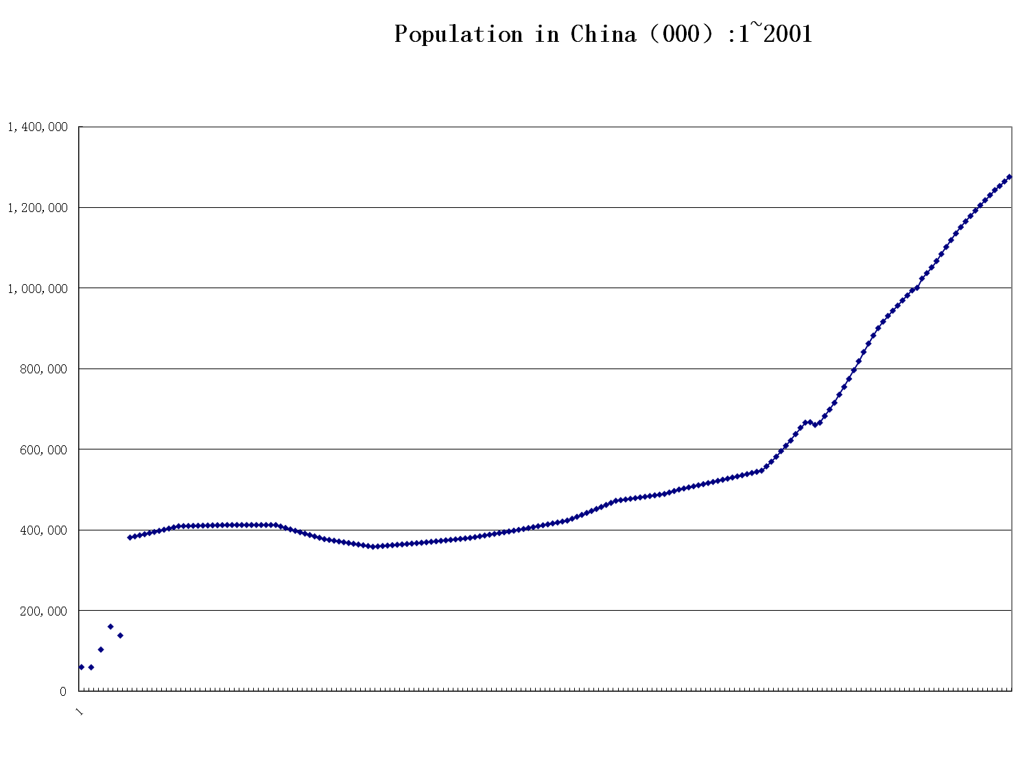
1949 was a turning point

Slide 5
The Achievements of New China 1.0
Preliminarily Industrialized the Economy
Established a Independent and Comprehensive Industrial system
GDP Growth Rate Averaged at 6.68% per year during 1953-1978
Life Expectancy increased from around 35 to about 67 years.

Slide 6
Evolvement of the Growth Models since 1978
Relatively
Balanced/Outward
Looking Growth
Imbalanced/outward
Looking
Balanced/Inward
Looking Growth
New growth model?
Planned Economy
With
Market Mechanism
Marketization
Privatization
Liberalization
Over-dependent
On
International Market
And
Investment
Sustainable
(Economic,
Social, Environment)
Development
1978
1992
2001
2012?

Slide 7
20+ times Increase in GDP
9.8
Source: CSY2013, NSB
15+ times Growth with per capita GDP

Slide 8
Over-dependence on Investment
Source: CYS 2014

Slide 9
Over-dependency on International Trade
Source: WDI 2014

Slide 10
China’s Consumption:1978-2012 (as % of GDP)
Source: CYS 2013, CSA 2014

Slide 11
The Widening Income Inequality
Notes:
11
11

Slide 12
China will still Grow fastly

Slide 13
The Change of International Trade

Slide 14
Residential House Index

Slide 15
From Deflation to Inflation

Slide 16
China’s GDP Growth(%):2006Q1~2014Q4

Slide 17
Rapid Growth of Government Revenue and expenditure
Tr.RMB
%
In 2014, it was estimated government revenue would be 14+Tr.RMB. Besides, the PBOC's Fiscal Deposit is 3.13 Tr. RMB at the end of 2014, and ranged between 2.84 to 4.54 Tr. RMB in 2014.

Slide 18
Low External Debt Risk
Risk Indicators on External Debts of China(%): 1985-2013
Source: CSA 2014

Slide 19
Monetary Policies-RRR
Now M2 is 107.74 Tr. RMB, Lower 1 percentage point of RRR would release around 1.08 Tr. RMB money supply.
No change for big and middle sized banks then after
Notes:
中国人民银行决定从2014年4月25日起下调县域农村商业银行人民币存款准备金率2个百分点，下调县域农村合作银行人民币存款准备金率0.5个百分点

Slide 20
Monetary Policies-Interest Rate

Slide 23
Latest Development
eliminated or reduced regulations concerning price
eliminated or reduced regulations market entry barriers in relation to trade in both goods and services
removal of administrative approval procedures in certain sectors
Finance
Private banks
Bank failure and deposit insurance
Expanding QFII and QDII
Capital account—internationalization of RMB

Slide 24
Figure 1. China’s Balance of Payment (US dollar 100 million)
Sources: China Statistical Yearbook and China Financial Yearbook, various issues.

Slide 25
Figure 2. Capital Account Balances (US dollar 100 million)
Sources: China Statistical Yearbook and China Financial Yearbook, various issues.

Slide 26
Figure 3. “Unaccounted for” Capital Flows
Sources: China Statistical Yearbook and China Financial Yearbook, various issues. Note: A = errors and omissions;
B = change in official reserves – current account balance – net FDI.

Slide 27
Thank You!

