Slide 1

Regional Dimensions of the Global Recovery:US
JAN KREGEL
Workshop on
Diverse Regional Responses to the Global Crisis: Implications for Finance and the Real Economy
Organised by International Development Economics Associates (IDEAs)
24-26 January, 2015, Muttukadu, Chennai, India

Slide 2
GDP = C + I + G + (X-M)
In the December GDP report the values for that equation (total dollars, percentage of the total GDP, and contribution to the final percentage growth number) were as follows :
            GDP = C + I + G + (X-M)
Annual $ (trillion $17.6 = $12.0 + $2.9 + $3.2 +. $-0.5
% of GDP 100.0% =. 68.2%+ 16.5% + 18.2% + -2.9%
Contribution to
GDP Growth %. 4.96% = 2.21% + 1.18% + 0.80% +. 0.77%

Slide 3
Quarterly Changes in % Contributions to GDP
3Q-2014. 2Q-2014 1Q-2014 4Q-2013 3Q-2013 2Q-2013 1Q-2013
Total GDP Growth 4.96%. 4.59% -2.11%. 3.50%. 4.51% 1.77% 2.75%
Consumer Goods 1.06% 1.33% 0.23% 0.83% 0.80% 0.30% 1.35%
Consumer Services 1.15%. 0.42% 0.60% 1.69% 0.59% 0.93% 1.11%
Fixed Investment 1.21% 1.45% 0.03%. 0.95% 1.01% 0.74% 0.42%
Inventories. -0.03%. 1.42% -1.16%. -0.34% 1.49% 0.30% 0.70%
Government. 0.80%. 0.31% -0.15%. -0.71% 0.04% 0.04% -0.75%
Exports 0.61%. 1.43% -1.30%. 1.30% 0.67% 0.82% -0.12%
Imports 0.16%. -1.77% -0.36%. -0.22% -0.09%. -1.36% 0.04%
Real Final Sales 4.99% 3.17% -0.95%. 3.84% 3.02% 1.47% 2.05%

Slide 4
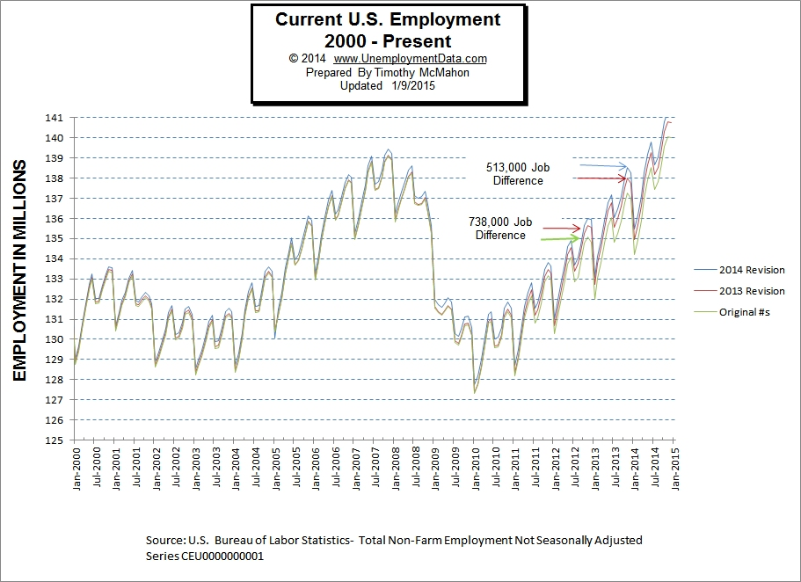

Slide 5
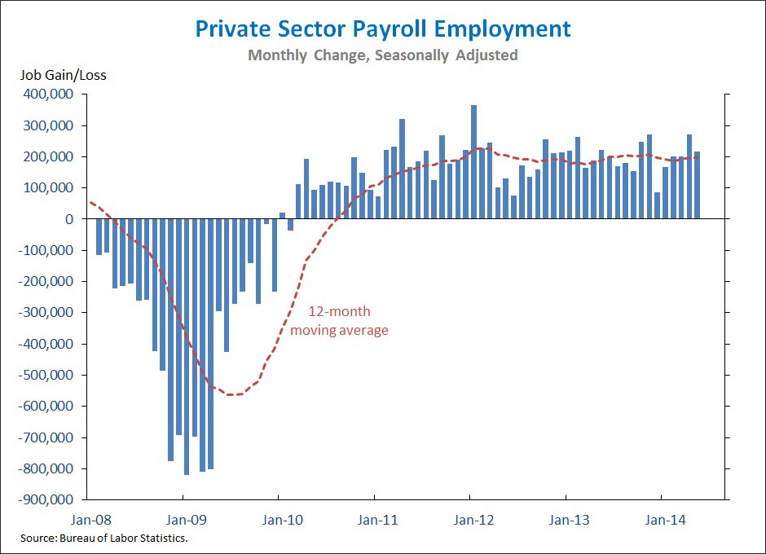

Slide 6
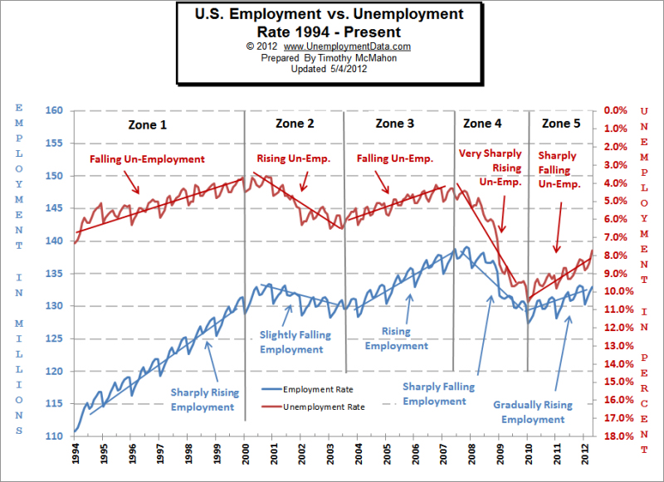

Slide 7
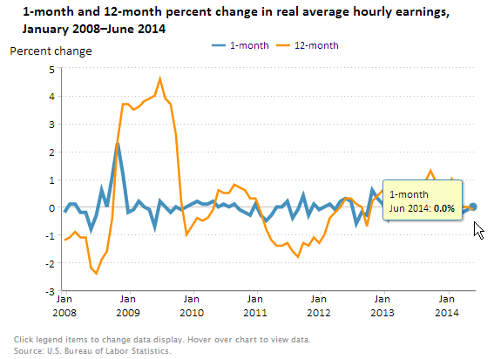

Slide 8
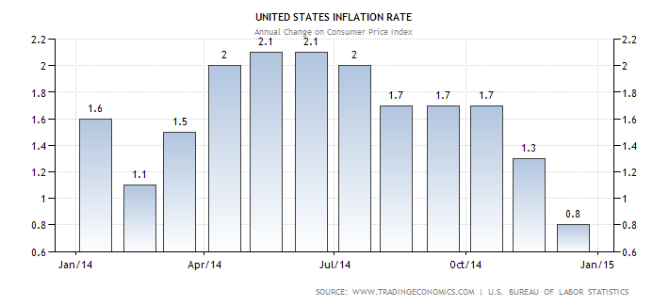

Slide 9
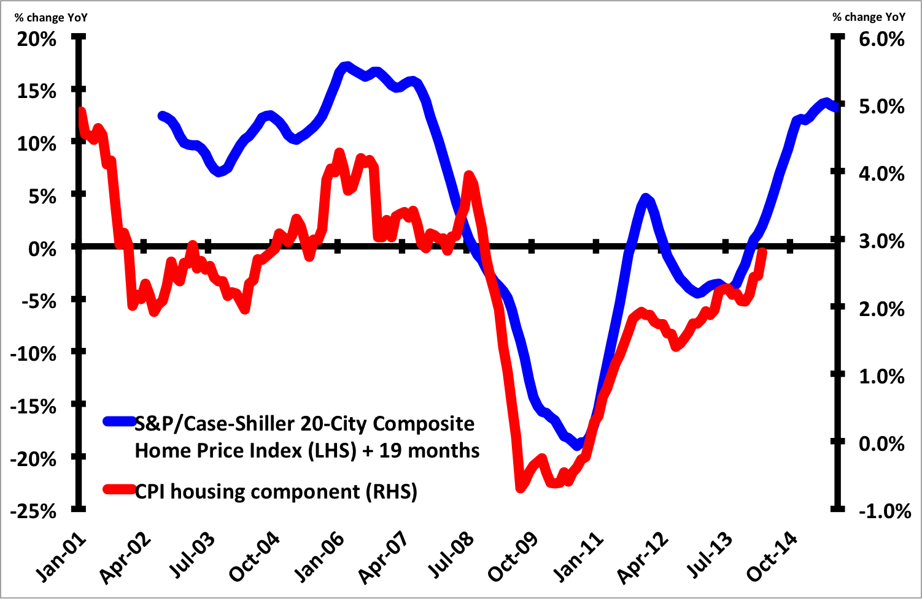

Slide 10
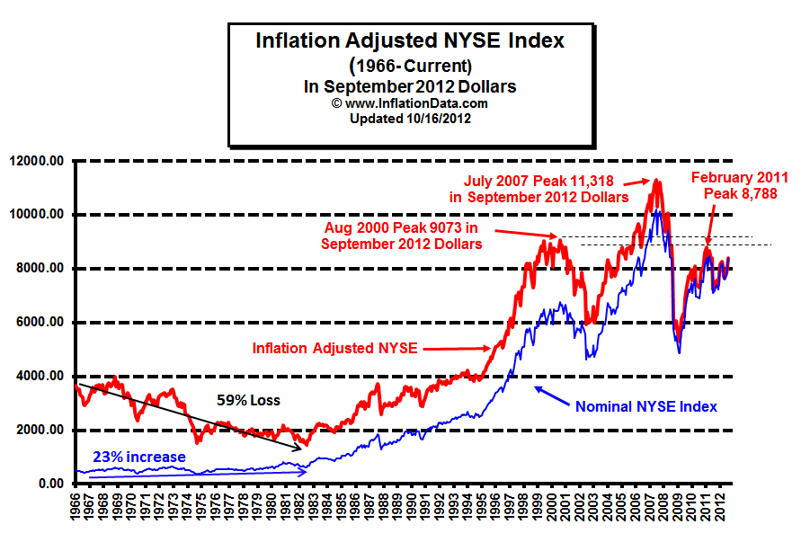

Slide 11
