Slide 1
Contract farming in India:
A Case study of potato cultivation
Parthapratim Pal
Indian Institute of Management Calcutta

Slide 2
Background
Value addition in Indian agriculture has been low as the level of processing in this sector has been poor
Ghosh, Bhandari and Sharma (2013) show extent of processing in Indian fruits and vegetables to be 1.7 percent and 2.4 percent respectively
Share of processing in advanced developing countries in these sectors vary between 30 to 50 percent. These shares are even higher for developed countries.

Slide 3
Contract Farming in India
To improve value addition it is suggested that it is important to link agriculture production with the complete agriculture value chain
Contract farming is seen as a possible way of integration in the global value chain
Domestic and foreign companies are gradually getting into contract farming and sourcing more agricultural products from India
This has raised the question whether the unequal bargaining power between domestic farmers and large corporates will lead to exploitation of farmers

Slide 4
Contract Farming in India
Contract farming can take various forms:
  procurement contracts under which only sale and purchase conditions are specified;
  partial contracts wherein only some of the inputs are supplied by the contracting firm and produce is bought at pre-agreed prices; and
  total contracts under which the contracting firm supplies and manages all the inputs on the farm and the farmer becomes just a supplier of land and labour.
In India, most contract farming arrangements are not backed by formal contract agreements.
These are implicit trading arrangements between the buyer and the seller.
Examples:
  ITC Limited’ and tobacco growers in Andhra Pradesh
  Nestle India and dairy farmers in Punjab
  Pepsico India and potato growers in Gujarat, Karnataka and West Bengal
  Pepsico India’s experiment with tomato growers in Punjab,
  ITC Limited’s arrangement with vegetable growers in Punjab

Slide 5

Contract Farming as CSR
Project Unnati is a collaborative effort of Coca-Cola with Jain Irrigation to build a sustainable supply chain for Coke's mango beverage, Maaza.
The program offers financial support and imparts training on Ultra High Density Plantation, a modern farming technique.
From the Project Unnati website:
  Project Unnati set to be a key milestone towards the large scale adoption of Ultra High Density farming Practice (UDHP) leveraging drip irrigation
  Introduction of Ultra High Density Plantation will double the average mango yields
  Project Unnati has the potential to improve the livelihoods of more than 50,000 farmers in the next five years
  Farms under Project Unnati will also be used to showcase and train farmers on Ultra High Density Plantation under a joint capability building program led by Jain Irrigation and Coca-Cola University

Slide 6
Some Preliminary Observations about contract farming
To understand how contract farming works we carried out a survey of potato farmers in West Bengal and Gujarat
In West Bengal potato farmers we surveyed are either contract farmers for Pepsico or they were doing non-contract farming
Both types of farming are being done almost side by side. Some farmers even do both contract and non-contract farming
In one of the regions surveyed, smaller farmers seemed more keen on contract farming than the medium farmers
In Gujarat we studied some large farmers who are contract farmers for an Indian company- Balaji Group

Slide 7
Why only some farmers are interested in contract farming while others are not?
This study tries to understand the decision making process followed by the farmers of potato in presence of two different cultivation models
  The prevailing farming model
  The so-called contract/contact/collaborative farming model.
In a way, the decision making process is similar to economic models where an economic agent chooses between two outcomes: a risky but more rewarding one and one with lesser risk and lesser reward

Slide 8
Some features of the prevailing system of potato farming in West Bengal:
Traditional potato farming in West Bengal suffers from a number of problems and uncertainties:
  Quality of seeds
  Timely availability of seeds
  Issues related to rural credit
  Lack of extension services from the government. This seems to be a major problem in the areas we visited.
  High use of chemical fertilisers- soil degradation
  High variability of the post harvest price
  No MSP in potato
  Storage related problems

Slide 9
Some features of the contract farming…1
Farmers are offered a pre-determined price before the farming season
This offered price is based on the quality of the output. In case of potato, potatoes of a standard size gets a higher price.
Potatoes which do not conform to that standard receive a lower price or they are not taken by Pepsi
The inputs are provided by the contracting firm as credit. However, longer term fixed capital loans and consumption loans are outside the deal.
The inputs are more organic in nature compared to the traditional farming. It is possibly for meeting domestic and international food standards

Slide 10
Some features of the contract farming…2
Potatoes cultivated are not of the table variety. ‘Atlanta’ is the most used variety of potato. This variety does not have a local market due to its different taste.
Irrigation and plantation techniques are different in contract farming. They are aimed more towards achieving the right size and quality of the product.
Extension services are provided by the contracting firm
Inputs and extension services are provided through a local nodal farmer who also acts as an aggregator
Farmers get a payment based on the net amount receivable to them at the end of the season
Farmgate collection of output is done.

Slide 12
Some features of the contract farming…3
Due to differences in potato variety, plantation technique, fertilisers used and irrigation technique –output per unit of land is lower in contract farming (6:5 ratio)
But the potatoes are of better quality and more uniform size. The emphasis is on meeting specifications for mechanized production of chips and food standards.
Last year Pepsi offered rates of Rs 850/q for good potatoes and about 400 Rs/q for bad sized potatoes. In some regions, bad sized potatoes were totally rejected.
Bad size potato ratio can be between 10 percent to 30 percent. The rejection rates vary quite widely from year to year and from region to region.
  Farmers cannot sell the rejected Atlanta potatoes in the local market. They mix it with table varieties to sell

Slide 13
For regular cultivators
The post harvest price can be highly volatile and can move between 500Rs/q to 2000 Rs/q over the next 7-8 months
For the traditional farmer, the price that he receives from selling his product is uncertain. It can be a function of various things including time, total supply, supply in other states, other demand-supply issues and speculative factors.
The rate of interest from village moneylenders may vary between farmers but the modal value is around 10 percent for the potato cropping season (November to March)

Slide 14
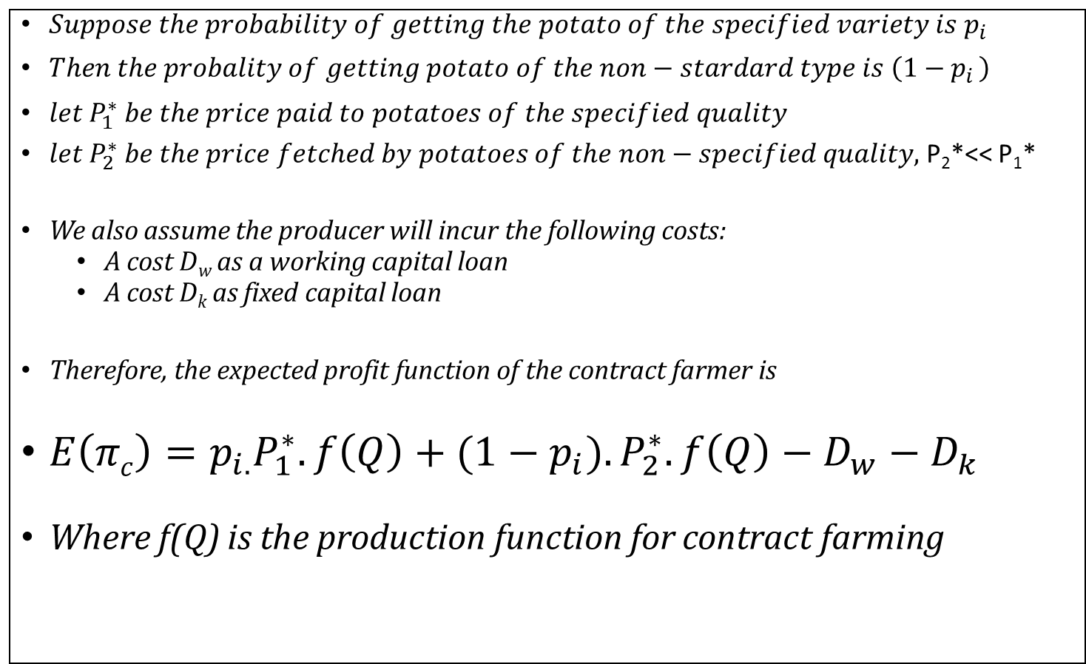
The profit function of the Contract farmer
$Suppose the probability of getting the potato of the specified variety is p_{i}$
$Then the probality of getting potato of the non−stardard type is \left(1−p_{i }\right)$
$let P_{1}^{∗} be the price paid to potatoes of the specified quality$
$let P_{2}^{∗} be the price fetched by potatoes of the non−specified quality,$P₂*<< P₁*
We also assume the producer will incur the following costs:
  A cost D_{w} as a working capital loan
  A cost D_{k} as fixed capital loan
Therefore, the expected profit function of the contract farmer is
$E\left(πc\right)=p_{i.}P_{1}^{∗}.f\left(Q\right)+{(1−p}_{i}{).P}_{2}^{∗}.f\left(Q\right)−D_{w}−D_{k}$
Where f(Q) is the production function for contract farming

Slide 15
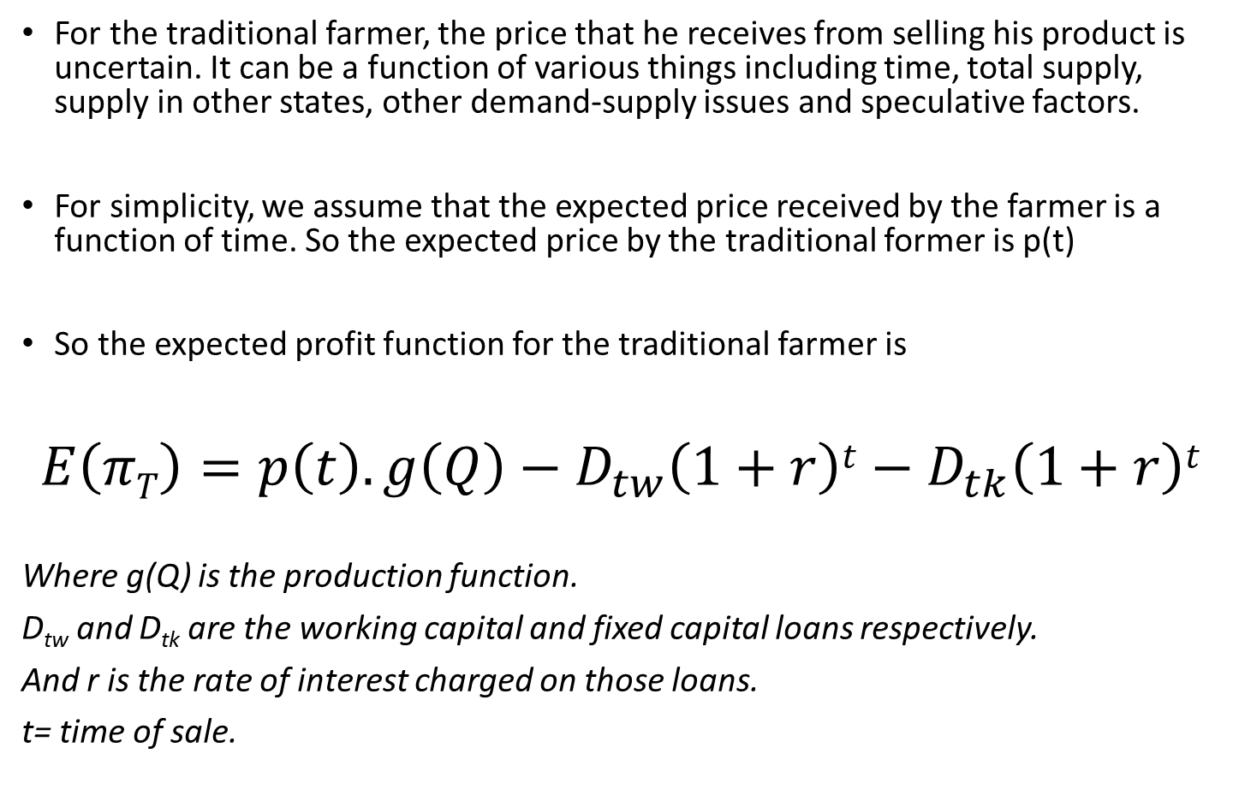
Profit function of the standard potato farmer
For the traditional farmer, the price that he receives from selling his product is uncertain. It can be a function of various things including time, total supply, supply in other states, other demand-supply issues and speculative factors.
For simplicity, we assume that the expected price received by the farmer is a function of time. So the expected price by the traditional former is p(t)
So the expected profit function for the traditional farmer is
$$E\left(πT\right)=p\left(t\right).g\left(Q\right)−D_{tw}\left(1+r\right)t−D_{tk}\left(1+r\right)t$$
Where g(Q) is the production function.
D_{tw} and D_{tk} are the working capital and fixed capital loans respectively.
And r is the rate of interest charged on those loans.
t= time of sale.

Slide 16
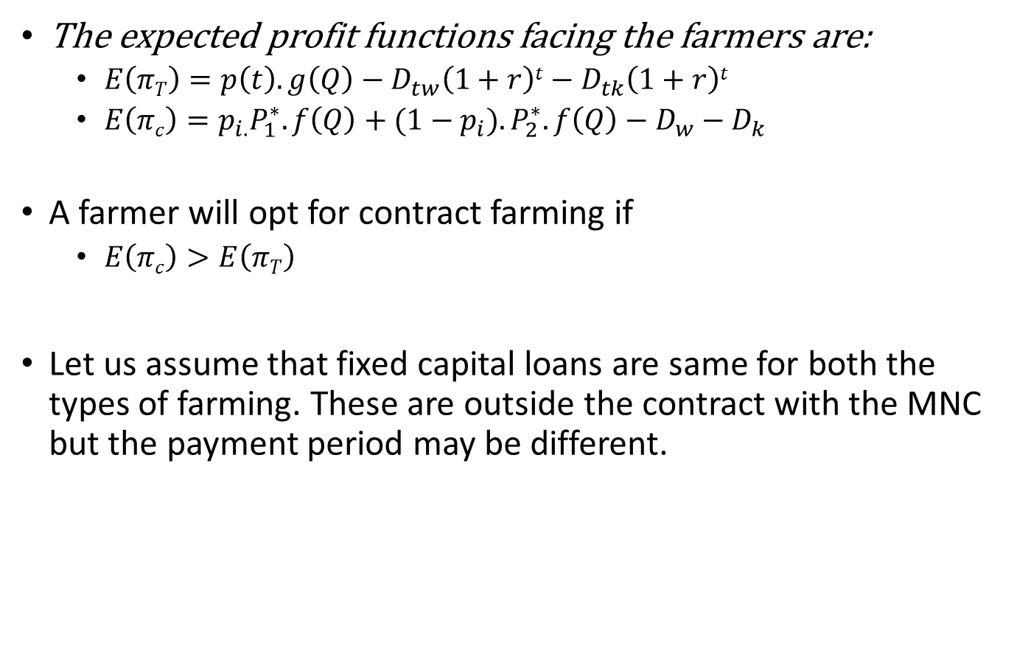
The choice facing the farmers…1
The expected profit functions facing the farmers are:
  $E\left(πT\right)=p\left(t\right).g\left(Q\right)−D_{tw}\left(1+r\right)t−D_{tk}\left(1+r\right)t$
  $E\left(πc\right)=p_{i.}P_{1}^{∗}.f\left(Q\right)+{(1−p}_{i}{).P}_{2}^{∗}.f\left(Q\right)−D_{w}−D_{k}$
A farmer will opt for contract farming if
  $E\left(πc\right)>E\left(πT\right)$
Let us assume that fixed capital loans are same for both the types of farming. These are outside the contract with the MNC but the payment period may be different.

Slide 17
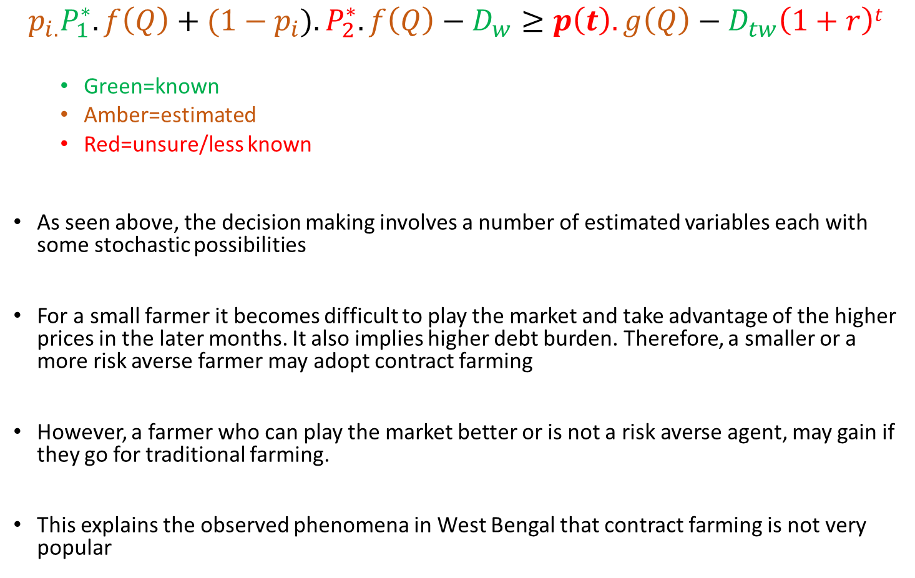
The decision making process:
  $$p_{i.}P_{1}^{∗}.f\left(Q\right)+{(1−p}_{i}{).P}_{2}^{∗}.f\left(Q\right)−D_{w}≥p\left(t\right).g\left(Q\right)−D_{tw}\left(1+r\right)t$$
  Green=known
  Amber=estimated
  Red=unsure/less known
As seen above, the decision making involves a number of estimated variables each with some stochastic possibilities
For a small farmer it becomes difficult to play the market and take advantage of the higher prices in the later months. It also implies higher debt burden. Therefore, a smaller or a more risk averse farmer may adopt contract farming
However, a farmer who can play the market better or is not a risk averse agent, may gain if they go for traditional farming.
This explains the observed phenomena in West Bengal that contract farming is not very popular

Slide 18
Some concluding observations…1
The contract farming model does not bring in many new innovations. It is a combination of:
  Supply of input credit
  Supply of quality inputs
  Provisions of extension services
  An assured price
  Farmgate collection of output
By providing these services, it is allowing the corporates to get a steady and quality supply of inputs
But are the prices received by the farmers ‘fair prices’ ?

Slide 19
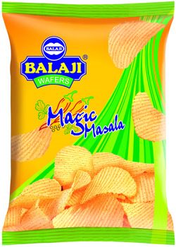
Some concluding observations
We interviewed a much bigger potato farmers in Gujarat and they receive much higher price for his contracted output.
  He supplies to the Balaji group and receives around 40% higher prices than what Pepsi offers to farmers in WB.
In West Bengal, contract farming is a Monopsony market and the farmers can get a better deal if they negotiate as a group

Slide 20
Possible Group formations
Formation of producers groups can
  Improve bargaining power among small farmers
  Give them some benefits of scale
  Move from a largely intermediary driven process to producer driven process
Present Thrust:
  Formation of Farmer-Producers Organizations (FPOs)
  Encouragement for emergence of so-called Social-Entrepreneurs
Lack of knowledge about these initiatives and low trust levels among rural population after the chit fund scam is affecting their growth in WB.
These are new initiatives and it is an open question whether FPOs and Social Entrepreneurs will be able to reduce the uneven bargaining power in this sector.
Unless that happens higher processing may not result in overall improvement of agriculture.

Slide 21
Thank you
Feedbacks are most welcome…
parthapal@iimcal.ac.in

Slide 22
FPOs: the current favourite
The Agriculture Ministry has proposed amendments to the NCDC Act to include farmer producer organisations (FPOs) for extending financial assistance and government subsidies.
The government is encouraging setting up of FPOs in a big way and trying to provide credit facilities through various schemes so that FPOs become viable.
FPOs, which are registered under the Companies Act, are firms consisting of small and marginal farmers. There are total 300 FPOs in India supported by government body Small Farmers Agribusiness Consortium (SFAC).
Financial assistance is being given for production, processing, marketing, storage, export and import of agricultural produce and other notified commodities.

Slide 23
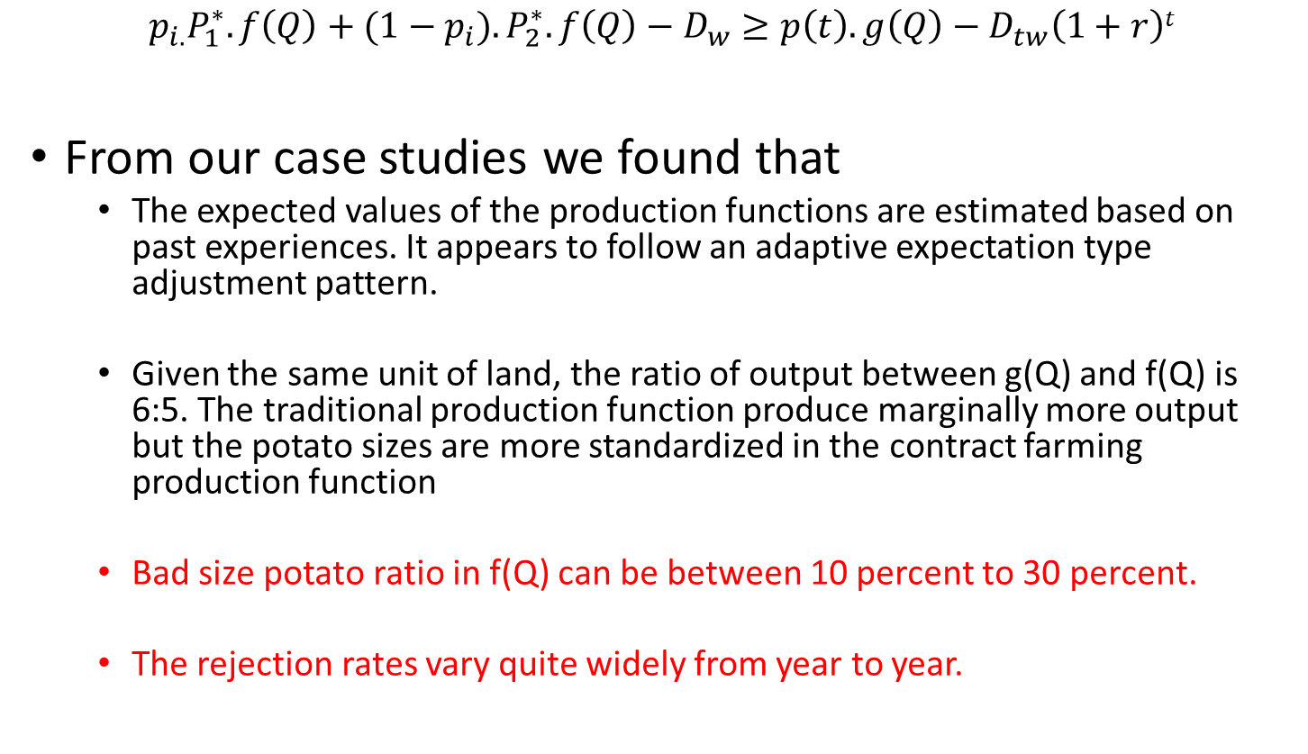
Estimation by the farmers of the unknown variables…1
  $$p_{i.}P_{1}^{∗}.f\left(Q\right)+{(1−p}_{i}{).P}_{2}^{∗}.f\left(Q\right)−D_{w}≥p\left(t\right).g\left(Q\right)−D_{tw}\left(1+r\right)t$$
From our case studies we found that
  The expected values of the production functions are estimated based on past experiences. It appears to follow an adaptive expectation type adjustment pattern.
  Given the same unit of land, the ratio of output between g(Q) and f(Q) is 6:5. The traditional production function produce marginally more output but the potato sizes are more standardized in the contract farming production function
  Bad size potato ratio in f(Q) can be between 10 percent to 30 percent.
  The rejection rates vary quite widely from year to year.

Slide 24
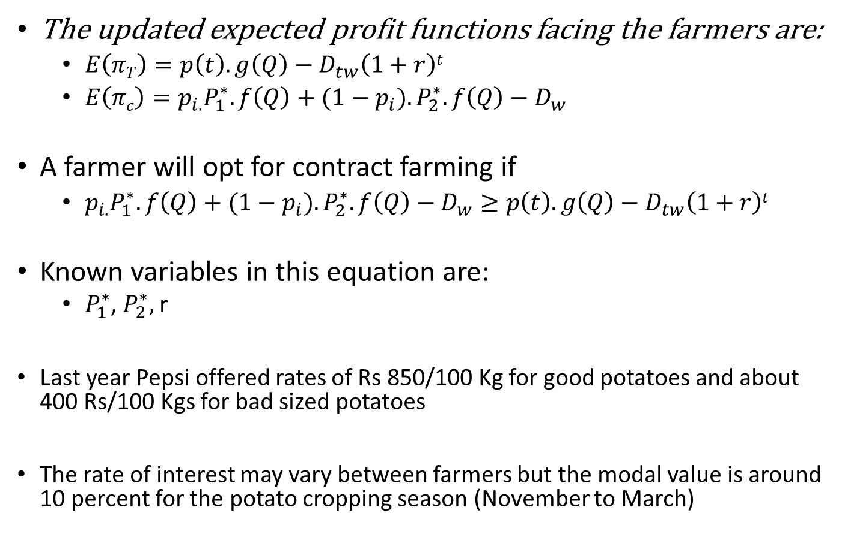
The choice facing the farmers…2
The updated expected profit functions facing the farmers are:
  $E\left(πT\right)=p\left(t\right).g\left(Q\right)−D_{tw}\left(1+r\right)t$
  $E\left(πc\right)=p_{i.}P_{1}^{∗}.f\left(Q\right)+{(1−p}_{i}{).P}_{2}^{∗}.f\left(Q\right)−D_{w}$
A farmer will opt for contract farming if
  $p_{i.}P_{1}^{∗}.f\left(Q\right)+{(1−p}_{i}{).P}_{2}^{∗}.f\left(Q\right)−D_{w}≥p\left(t\right).g\left(Q\right)−D_{tw}\left(1+r\right)t$
Known variables in this equation are:
  $P_{1}^{∗}$, $P_{2}^{∗},$r
Last year Pepsi offered rates of Rs 850/100 Kg for good potatoes and about 400 Rs/100 Kgs for bad sized potatoes
  The rate of interest may vary between farmers but the modal value is around 10 percent for the potato cropping season (November to March)

Slide 25
Contract (Contact) farming in West Bengal
Contract farming is formally not allowed in West Bengal- such contracts are not legally enforceable
However, a number of companies, including Pepsi is getting into informal/semi-formal contracts with farmers to secure supply for their retail products. Pailan group and Mcain are other major players.
To avoid legal hassles Pepsi calls it ‘contact farming’ or ‘collaborative farming’.
Pepsi is active in West Bengal, as it is in some other states, in collaborative farming.
According to its website:
  PepsiCo works with around 24,000 farmers across nine states under collaborative farming model, procures around 45 per cent of its current total requirement of 2.40 lakh tonnes of potato per annum by working with farmers and the rest 55 per cent from the open market.
Pepsi intends to scale up this process and procure 65 per cent of its requirements directly from the farmers in two years time.

Slide 26
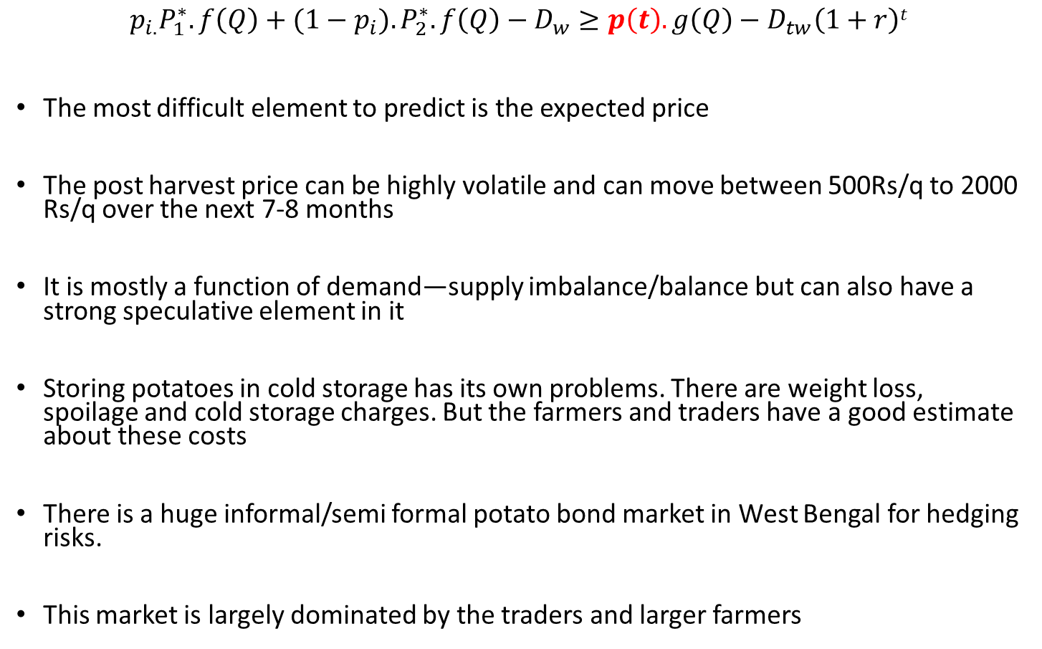
Estimation by the farmers of the unknown variables…2
  $$p_{i.}P_{1}^{∗}.f\left(Q\right)+{(1−p}_{i}{).P}_{2}^{∗}.f\left(Q\right)−D_{w}≥p\left(t\right).g\left(Q\right)−D_{tw}\left(1+r\right)t$$
The most difficult element to predict is the expected price
The post harvest price can be highly volatile and can move between 500Rs/q to 2000 Rs/q over the next 7-8 months
It is mostly a function of demand—supply imbalance/balance but can also have a strong speculative element in it
Storing potatoes in cold storage has its own problems. There are weight loss, spoilage and cold storage charges. But the farmers and traders have a good estimate about these costs
There is a huge informal/semi formal potato bond market in West Bengal for hedging risks.
This market is largely dominated by the traders and larger farmers

