Slide 1
Basel III and the Control of Financial Fragility
Workshop on “Regulating finance after the global crisis”
Organised by IDEAs and Centre for Banking Studies, Central Bank of Sri Lanka
Colombo 21-24 November 2011
Mario Tonveronachi
University of Siena, Italy

Slide 2
The Stages of the Basel Accords
Basel I (1988 → end 1992)
  Directed at large international banks; the catchword was the regulatory level playing field; focus on risk-sensitive minimum capitalisation; simple metrics for credit risk
Basel I.5 (1996 → 1997)
  Sorry, we forgot market risk. Introduction of the VAR approach for market risk based on banks’ internal models
Core Principles for Effective Banking Supervision (1997)
  A Manual for the good supervisor (and good banker) based on industry’s best practices. It calls for a more comprehensive risk management framework than the capital rule

Slide 3
The Stages of the Basel Accords
Basel II (2004 → end 2006 - 2007)
  Sorry, we forgot operational risk
  Generalisation of the VAR approach to the three types of risk; rationalisation of the entire regulatory building by means of the three Pillars. The crucial role played by Pillar 2 for the effectiveness of the entire construction. Complexity of risk metric and supervisory review processes SRP
Basel II.5 (2009 → end 2011)
  Sorry, we mis-calibrated the risk metric for market risk and securitisation
  Higher capital requirements for both the trading book and complex securitisation exposures. The enhanced treatment comes from stressed value-at-risk capital requirements, and higher capital requirements for so-called resecuritisations in both the banking and the trading book.

Slide 4
The Stages of the Basel Accords
Basel III (2011 → 2013 - 2019)
  Sorry, we:
  forgot liquidity risk
  underestimated counterparty risk
  overestimated the efficacy of Pillar 1 in containing leverage
  underestimated the losses that capital should absorb
  did not consider the greater risk that SIFIs pose to the financial systems
  did not pay enough attention to the pro-cyclicality produced by capital requirements
Hence:
  the 3 Pillars must be strengthened
  the micro-prudential approach to regulation must be completed by macro-prudential policies

Slide 5
Changes Introduced by Basel III
Capital |  |  |  |  |  | Liquidity
 | Pillar 1 |  |  | Pillar 2 | Pillar 3 | Global liquidity standard and supervisory monitoring
 | Capital | Risk coverage | Containing leverage | Risk management and supervision | Market discipline
All banks | Quality and level of capital “Gone concern” contingent capital Capital conservation buffer Countercyclical buffer | Securitisations Trading book Counterparty credit risk | Leverage ratio | Supplemental Pillar 2 requirements | Revised Pillar 3 disclosure requirements | Liquidity coverage ratio Net stable funding ratio Principles for Sound Liquidity Risk Management and Supervision Supervisory monitoring
G-SIFIs | Methodology to identify G-SIFIs Additional capital requirement adding from 1% to 2.5% of CET1

Slide 6
Pillar 1 - Calibration of Capital Requirements
All numbers in %. In parenthesis Basel II requirements.
 | Common Equity Tier 1 | Tier 1 | Tier 2 | Total Capital
Minimum | 4.5 (2.0) | 6.0 (4.0) | 2.0 (4.0) | 8.0 (8.0)
Conservation buffer | 2.5 |  |  | (Pillar 2)
Minimum plus conservation buffer | 7.0 | 8.5 | 2.0 | 10.5 (8.0+Pillar 2)
Countercyclical buffer range* | 0 – 2.5
* Common equity or other fully loss absorbing capital
Tier 1 => absorbing losses on a “going concern” (solvent)
Tier 2 => absorbing losses on a “gone concern” (liquidation)

Slide 7
Pillar 1 - Capital Conservation Buffer
2.5% of common equity. Common equity must first meet the minimum capital requirements (including the 6% Tier 1 and 8% Total capital requirements if necessary), before the remainder can contribute to the capital conservation buffer
Smooth banks’ idiosyncratic pro-cyclicality: not obliged to raise new capital but re-build in time the buffer by limiting distribution of earnings
Individual bank minimum capital conservation standards
Common Equity Tier 1 Ratio | Minimum Capital Conservation Ratios (expressed as a percentage of earnings)
<7% and no positive earnings | 100%
4.5% - 5.125% | 100%
>5.125% - 5.75% | 80%
>5.75% - 6.375% | 60%
>6.375% - 7.0% | 40%
>7.0% | 0%

Slide 8
Pillar 1 - Capital Countercyclical Buffer
0% – 2.5% of fully absorbing capital instruments
To smooth systemic pro-cyclicality
It will be deployed by national jurisdictions when excess aggregate credit growth is judged to be associated with a build-up of system-wide risk to ensure the banking system has a buffer of capital to protect it against future potential losses
Like the conservation buffer, banks will be subject to restrictions on distributions if they do not meet the requirement

Slide 9
Pillar 1 – Risk Coverage
Securitisations
  Higher risk weights, already decided in Basel II.5
Trading book
  Higher risk weights, already decided in Basel II.5
Counterparty credit risk
  More stringent requirements for measuring exposures
  Capital incentives for banks to use central counterparties for derivatives
  Higher risk weights for inter-financial sector exposures

Slide 10
Pillar 1 – Containing Leverage
Definition:
  Capital measure: tentatively Tier 1 capital
  Exposure measure: includes off-balance sheet exposures with a 100% credit conversion factor
Proposed tentative calibration of 3% minimum leverage ratio
Its objective seems to constrain outliers

Slide 11
Pillar 1 – Containing Leverage
Leverage (Tangible total assets / Net tangible capital)
 | 2007 | 2010
Rabobank | 19.8 | 17.5
INTESA SANPAOLO | 20.5 | 22.1
HSBC HOLDINGS | 21.4 | 20.4
BANCO SANTANDER | 21.6 | 22.5
BBVA | 24.4 | 18.5
UNICREDIT | 27.5 | 21.5
CREDIT SUISSE | 34.9 | 48.5
BNP PARIBAS | 35.4 | 27.6
COMMERZBANK | 41.4 | 29.4
SOCIETE GENERALE | 43.0 | 26.7
Dexia | 44.1 | 66.8
ROYAL BANK OF SCOTLAND | 47.8 | 23.1
BARCLAYS | 50.4 | 27.6
CREDIT AGRICOLE | 52.3 | 50.0
ING group | 56.1 | 39.2
DEUTSCHE BANK | 67.2 | 54.4
UBS | 80.7 | 31.1
Large dispersion
Outliers (?!)
Some de-leveraging

Slide 12
Pillar 2
Heightened focus on:
  the governance of banks
  risk management, with particular attention to off-balance sheet exposures, risk concentration and stress testing
  sound compensation practices
  accounting standards
  supervisory colleges

Slide 13
Pillar 3
Enhanced disclosures, particularly for:
  securitisation
  off-balance sheet vehicles
  the components of regulatory capital

Slide 14
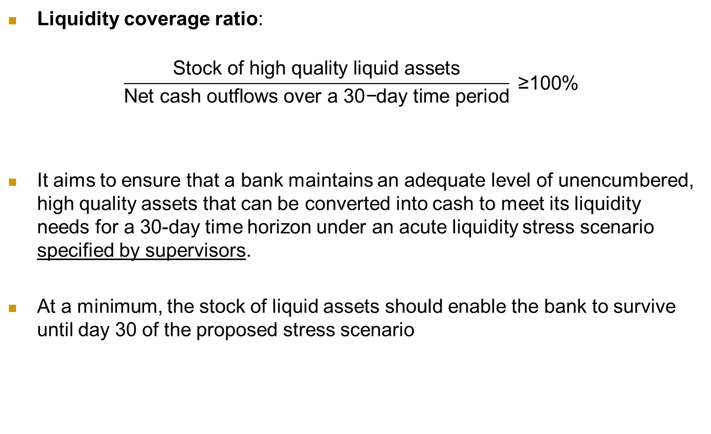
Liquidity
Liquidity coverage ratio:
$$\frac{\text{Stock} \text{of} \text{high} \text{quality} \text{liquid} \text{assets}}{\text{Net} \text{cash} \text{outflows} \text{over} \text{a}\text{ 30}\text{−}\text{day} \text{time} \text{period}}\text{ ≥100\%}$$
It aims to ensure that a bank maintains an adequate level of unencumbered, high quality assets that can be converted into cash to meet its liquidity needs for a 30-day time horizon under an acute liquidity stress scenario specified by supervisors.
At a minimum, the stock of liquid assets should enable the bank to survive until day 30 of the proposed stress scenario

Slide 15
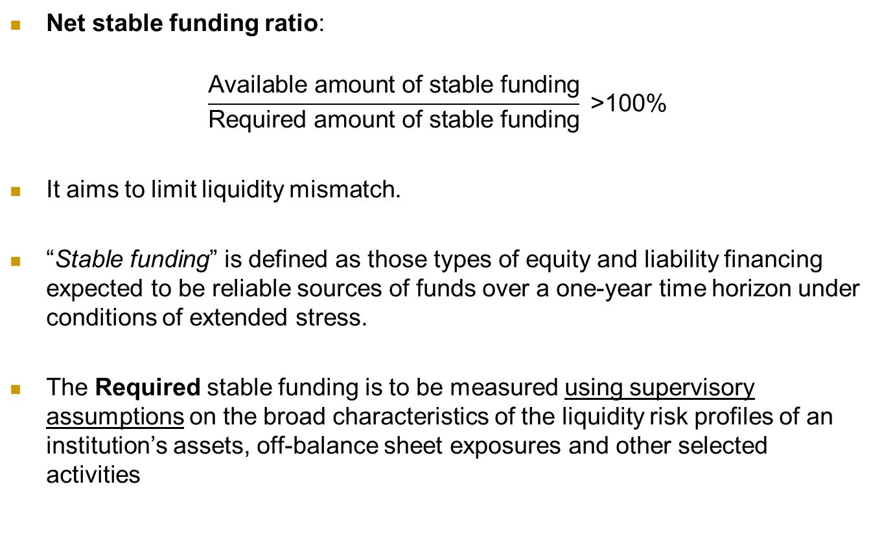
Liquidity
Net stable funding ratio:
$$\frac{\text{Available} \text{amount} \text{of} \text{stable} \text{funding}}{\text{Required} \text{amount} \text{of} \text{stable} \text{funding}}\text{ >100\%}$$
It aims to limit liquidity mismatch.
“Stable funding” is defined as those types of equity and liability financing expected to be reliable sources of funds over a one-year time horizon under conditions of extended stress.
The Required stable funding is to be measured using supervisory assumptions on the broad characteristics of the liquidity risk profiles of an institution’s assets, off-balance sheet exposures and other selected activities

Slide 16
Liquidity
Problems:
Large supervisory discretion for crucial parameters
The new liquidity requirements add a lot of new complexity and fixed costs for both supervisors and bank treasurers. Inter alia, interaction between capital and liquidity requirements
Pro-cyclical effects

Slide 17
G-SIFIs (G-SIBs)
Definition of G-SIFIs in relation to their size, complexity and systemic interconnectedness
For G-SIBs, Basel III includes a further capital buffer (common equity) in the 1% - 2.5% range, according to the relevance of the bank. Another 1% might be added for G-SIBs that are increasing their global systemic relevance
Preliminary proposals are being developed to add requirements on contingent capital and bail-in debt with loss absorbency on a going concern (the Swiss model)
Other measures refer to liquidity surcharges, tighter restrictions and enhanced supervision on large exposures.
N.B. The reference to global banks may leave unaffected banks that are systemically relevant at a regional or national level. However, see Cannes G20 and next EU stress tests.

Slide 18
Phase-in Arrangements (shading indicates transition periods)
 | 2011 | 2012 |  | 2013 | 2014 | 2015 | 2016 | 2017 | 2018 | As of 1 January 2019
Leverage Ratio | Supervisory monitoring |  |  | Parallel run 1 Jan 2013 – 1 Jan 2017 |  |  |  |  | Migration to Pillar 1
Minimum Common Equity Capital Ratio |  |  |  | 3.5% | 4.0% | 4.5% | 4.5% | 4.5% | 4.5% | 4.5%
Capital Conservation Buffer |  |  |  |  |  |  | 0.625% | 1.25% | 1.875% | 2.5%
Minimum common equity plus capital conservation buffer |  |  |  | 3.5% | 4.0% | 4.5% | 5.125% | 5.75% | 6.375% | 7.0%
Minimum Tier 1 Capital |  |  |  | 4.5% | 5.5% | 6.0% | 6.0% | 6.0% | 6.0% | 6.0%
Minimum Total Capital |  |  |  | 8.0% | 8.0% | 8.0% | 8.0% | 8.0% | 8.0% | 8.0%
Minimum Total Capital plus conservation buffer |  |  |  | 8.0% | 8.0% | 8.0% | 8.625% | 9.25% | 9.875% | 10.5%
Liquidity coverage ratio | Observation period begins |  |  |  |  | Introduce minimum standard
Net stable funding ratio |  |  | Observation period begins |  |  |  |  |  | Introduce minimum standard
In reality markets already assess banks in relation to the new standards, looking at relative costs for reaching them, including limitations on dividends

Slide 19
Basel III and Financial Fragility
What should we ask to a reform of banking regulation?
It would be unfair to ask to a regulation directed at a portion of the financial system to be capable per se to shield the economy from systemic crises
It would be unwise to think that strong external shocks can be cushioned by the financial sector without the intervention of public policies. However, the degree of financial fragility of the entire economy is relevant to contain public intervention
Regulation should avoid the financial sector producing endogenous crises
Regulation and supervision should be simple, consistent and with low costs of compliance
Basel II had to be profoundly revised since it was too weak on its own merit

Slide 20
Basel III and Financial Fragility
We must then look at:
how Basel III relates to the rest of the perimeter of financial regulation
the contribution of Basel III to prevent the banking sector to endogenously produce systemic crises
If Basel III improves on complexity, consistency and costs

Slide 21
Basel III and the Regulatory Perimeter
Being directed at banks, Basel III mainly relies on proxy regulation. E.g. counterparty requirements on securitisation, OTCs and CCPs
Its new rules significantly increase compliance costs for banks. This will strengthen the push to shift activities outside the banking sector, thus increasing regulatory arbitrage and elusion
Reforms of regulatory perimeter:
Unfinished job. From what we can see from current interventions and proposals, the higher costs of banking regulation, the withdrawal of public guarantees from banks and the limited increase of regulatory costs outside banking will not produce a level-playing-field
Higher the compliance with the spirit of Basel III, less relevant it will finally result

Slide 22
Basel III and Endogenous Banking Fragility
I focus on two points: risk metric and financial dimension
Risk metric
Revision of the treatment for market risk and securitisation should produce higher risk weights
Crucial role of validation of internal risk models and stricter stress tests and backtesting
One goal was also to re-equilibrate the treatment between banking and trading books

Slide 23
Basel III and Endogenous Banking Fragility
Three problems
The starting point of risk weight for the trading book is so low that the expected threefold increase will hardly fill the gap
Experience shows how unwise is to count on supervisors to require stringent tests in ‘normal times’, and more in general to severely perform their duties under Pillar 2
To mend with stress tests a risk metric that has amply shown to be flawed shows a dangerous reluctance to think anew
The European experience
EU banks are thought to be subject to the common discipline of EU Directives and Regulations. However, the fine printing remains in the hand of national regulators and supervision is demanded to national authorities

Slide 24
Basel III and Endogenous Banking Fragility
- From EBA stress test July 2011
- RW appears linked to the exposure to market risks
- By 2012 the increase of RWs, with Basel II.5 fully applied, is non significant, despite a stressed scenario
- No re-equilibrating process; no general increase of RWs. Basel III should produce some increase for RW for counterparty risks
- But also heterogeneity of national supervisory practices
RW | EU banks among the 20 World largest for total assets |  |  |  | Sample without the largest banks
 |  |  | Baseline scenario |  |  | Baseline scenario
 |  | 2010 | 2011 | 2012 | 2010 | 2011 | 2012
DE | DEUTSCHE BANK | 0.18 | 0.22 | 0.23 | 0.27 | 0.27 | 0.27
NL |  |  |  |  | 0.32 | 0.32 | 0.32
BE |  |  |  |  | 0.33 | 0.36 | 0.38
FR | BNP PARIBAS | 0.30 | 0.33 | 0.34 | 0.41 | 0.42 | 0.44
 | SOCIETE GENERALE | 0.33 | 0.37 | 0.37
 | CREDIT AGRICOLE | 0.37 | 0.37 | 0.37
UK | BARCLAYS | 0.27 | 0.31 | 0.31 | 0.41 | 0.44 | 0.44
 | ROYAL BANK OF SCOTLAND | 0.45 | 0.46 | 0.45
 | HSBC | 0.46 | 0.51 | 0.51
 | LLOYDS BANK | 0.47 | 0.50 | 0.50
SE |  |  |  |  | 0.42 | 0.42 | 0.42
DK |  |  |  |  | 0.43 | 0.43 | 0.43
IE |  |  |  |  | 0.54 | 0.54 | 0.54
GR |  |  |  |  | 0.55 | 0.55 | 0.55
IT |  |  |  |  | 0.58 | 0.58 | 0.58
ES | SANTANDER | 0.49 | 0.50 | 0.51 | 0.63 | 0.63 | 0.63
AT |  |  |  |  | 0.64 | 0.67 | 0.67
PT |  |  |  |  | 0.67 | 0.67 | 0.67
Average |  | 0.37 | 0.40 | 0.40 | 0.48 | 0.49 | 0.49
Norm. SD |  | 0.27 | 0.24 | 0.24 | 0.27 | 0.27 | 0.26

Slide 25
Basel III and Endogenous Banking Fragility
A regulation based on capitalisation needs consistent definition of capital, risk metric and accounting rules and practices.
Basel III tries to restrict the discretion on the components of Tier 1 and Tier 2 capital
The unchanged risk methodology does not tackle the problem of the discretion of banks and national supervisors on risk metric. Adding differences in accounting standards and practices, we have the situation exemplified in the table
Crucial problem for a regulation based on capitalisation. The BCBS (2011) seems aware of the problem:
“The Committee agreed to review the measurement of risk-weighted assets in both the banking book and the trading book, to ensure that the outcomes of the new rules are consistent in practice across banks and jurisdictions.”
RW, % | 2008 | 2009
Europe | 31.9 | 34.6
USA | 67.1 | 67.7
Japan | 47.4 | 45.3

Slide 26
Basel III and Endogenous Banking Fragility
Bankarisation
  Growth of the systemic relevance of banking sectors
  Growth of the systemic relevance of large banks
Assets of resident banks, as a percentage of GDP
 | 2001 | 2004 | 2007
Austria | 259 | 265 | 310
Belgium | 284 | 303 | 361
Denmark | 247 | 284 | 365
Finland | 109 | 138 | 162
France | 266 | 281 | 361
Germany | 296 | 297 | 304
Greece | 139 | 130 | 156
Ireland | 414 | 555 | 831
Italy | 145 | 166 | 201
Netherlands | 279 | 323 | 358
Portugal | 212 | 235 | 246
Spain | 179 | 198 | 262
Sweden | 184 | 195 | 249
United Kingdom | 356 | 401 | 520
Source: ECB, Statistical Data Warehouse. Assets are annual averages.

Slide 27
Basel III and Endogenous Banking Fragility
Combined assets of the three or five largest banks relative to GDP
 | Top three banks |  |  | Top five banks
 | 1990 | 2006 | 2009 | 1990 | 2006 | 2009
France | 70 | 212 | 250 | 95 | 277 | 344
Germany | 38 | 117 | 118 | 55 | 161 | 151
Italy | 29 | 110 | 121 | 44 | 127 | 138
Japan | 36 | 76 | 92 | 59 | 96 | 115
Netherlands | 154 | 538 | 406 | 159 | 594 | 464
Spain | 45 | 155 | 189 | 66 | 179 | 220
Sweden | 89 | 254 | 334 | 120 | 312 | 409
United Kingdom | 68 | 226 | 336 | 87 | 301 | 466
United States | 8 | 35 | 43 | 11 | 45 | 58
Source: Goldstein and Véron 2011 on BIS data.

Slide 28
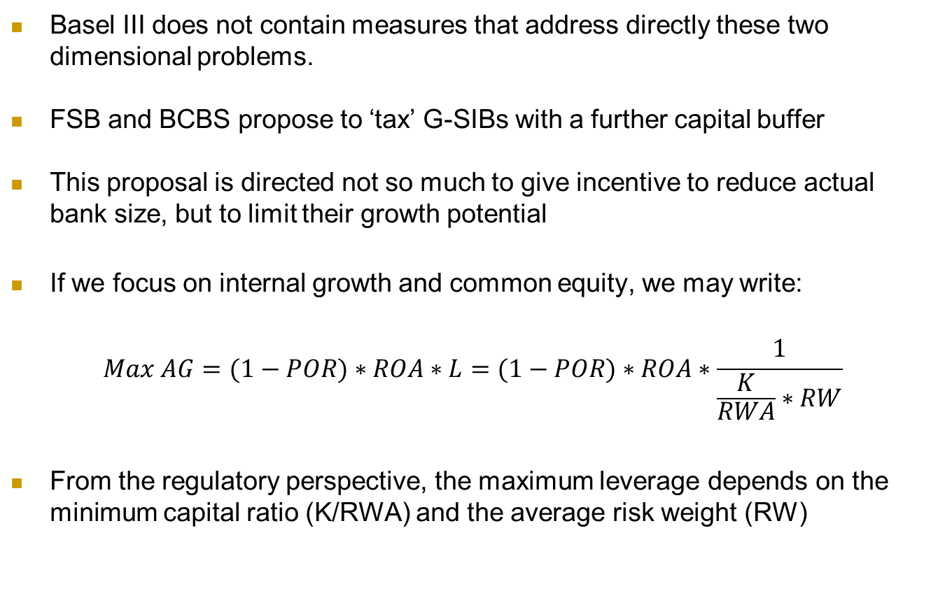
Basel III and Endogenous Banking Fragility
Basel III does not contain measures that address directly these two dimensional problems.
FSB and BCBS propose to ‘tax’ G-SIBs with a further capital buffer
This proposal is directed not so much to give incentive to reduce actual bank size, but to limit their growth potential
If we focus on internal growth and common equity, we may write:
$$Max AG=(1−POR)∗ROA∗L=(1−POR)∗ROA∗\frac{1}{\frac{K}{RWA}∗RW}$$
From the regulatory perspective, the maximum leverage depends on the minimum capital ratio (K/RWA) and the average risk weight (RW)

Slide 29
Basel III and Endogenous Banking Fragility
POR = 50%
Yellow:
Leverage ratio (Tier 1) < 3%
G-SIBs | ROA, % Av. 2001-10 | RW 2010 | % AG for K/RWA % = |  |  | Country nominal G% Av. 2001-2010 | Minimum Surplus AG
 |  |  | 7 | 9 | 10.5
UBS | 0.24 | 0.14 | 12.2 | 9.5 | 8.2 | 2.7 | 5.5
DEUTSCHE BANK | 0.21 | 0.18 | 8.2 | 6.4 | 5.5 | 2.4 | 3.1
CREDIT SUISSE | 0.37 | 0.20 | 13.2 | 10.3 | 8.8 | 2.7 | 6.1
HSBC HOLDINGS | 0.74 | 0.26 | 20.4 | 15.9 | 13.6 | 3.7 | 9.9
BARCLAYS | 0.54 | 0.27 | 14.4 | 11.2 | 9.6 | 3.7 | 5.9
BNP PARIBAS | 0.47 | 0.29 | 11.5 | 9.0 | 7.7 | 3.9 | 3.8
SOCIETE GENERALE | 0.40 | 0.30 | 9.6 | 7.5 | 6.4 | 3.9 | 2.5
ROYAL BANK OF SCOTLAND | 0.51 | 0.30 | 12.2 | 9.5 | 8.1 | 3.7 | 4.4
CREDIT AGRICOLE | 0.35 | 0.32 | 7.9 | 6.1 | 5.2 | 3.9 | 1.3
COMMERZBANK | 0.08 | 0.32 | 1.8 | 1.4 | 1.2 | 2.4 | -1.2
MIZUHO BANK | 0.11 | 0.34 | 2.3 | 1.8 | 1.5 | -0.5 | 2.0
ING BANK | 0.30 | 0.38 | 5.7 | 4.4 | 3.8 | 4.6 | -0.8
MITSUBISHI UFJ FG | 0.18 | 0.45 | 2.9 | 2.2 | 1.9 | -0.5 | 2.4
LLOYDS BANK | 0.74 | 0.46 | 11.4 | 8.9 | 7.6 | 3.7 | 3.9
UNICREDIT SPA | 0.66 | 0.48 | 9.8 | 7.6 | 6.5 | 3.8 | 2.7
CITIGROUP | 0.79 | 0.49 | 11.5 | 9 | 7.7 | 3.9 | 3.8
BANCO SANTANDER | 0.93 | 0.51 | 13.0 | 10.1 | 8.7 | 7.6 | 1.1
NORDEA | 0.65 | 0.52 | 8.9 | 6.9 | 5.9 | 3.4 | 2.5
IND & COMM BANK OF CHINA | 0.95 | 0.55 | 12.3 | 9.6 | 8.2 | 14.9 | -6.7
J P MORGAN | 0.65 | 0.57 | 8.1 | 6.3 | 5.4 | 3.9 | 1.5
BANK OF AMERICA | 0.93 | 0.60 | 11.1 | 8.6 | 7.4 | 3.9 | 3.5
Source of data: Bankscope and IMF.

Slide 30
Basel III and Endogenous Banking Fragility
Some remarks:
Banks significantly differ for both ROA and RW, producing a large dispersion for Max AG. With10.5% of capital coefficients, the growth of bankarisation does not disappear.
Since international banks work in countries with largely different nominal growth, macro-calibration with a single capital requirement to the different conditions is impossible
Banks more oriented to traditional business are penalised by higher RW, and lower AG if they do not adjust with ROA. This is relevant across countries and inside each country
Those who ask for much higher capital requirements should take into account that the conditions of profitability are not the ones of the 1950s and 1960s. On the contrary, profitability might in the future be still lower than in the recent past due to the new regulatory costs.

Slide 31
Basel III and Endogenous Banking Fragility
The one-size-fits-all Basel rule does not work: macro- and micro-prudential rules may easily conflict
Obliged by higher capital requirements, national supervisors might let banks adjust their RWs to permit them to follow nominal growth. Not a good result for a regulation based on risk metric

Slide 32
Basel III: An Overall Assessment
Although Basel III improves on some of the serious deficiencies of the previous releases:
It further adds significant complexity and regulatory costs
It neglects its negative effects on ROA, which should be regarded as the fundamental source of capital and long-run resilience
It increases the discretion on risk metric by banks and supervisors
Constrained by its methodology, it does not give a consistent meaning to regulatory ratios, i.e. to its entire construction, well after 20 years of the ‘Basel Regime’

