Slide 1
Regulation of the informal economy and employment in Ghana: A review of policies, laws and practices with special reference to contract farming and domestic trading
Promise Eweh
Institute of African Studies
University of Ghana

Slide 2
Introduction

Slide 3
Data Sources
World Development Indicators (WDI), World Bank
Ghana Living Standards Survey (GLSS)
Population and Housing Census Reports
The scholarly literature on the Ghanaian economy, labour issues, and the informal economy

Slide 4
Outline of Presentation
Macroeconomic and labour market context
Employment in Agriculture and Domestic Trading
Regulation and formalisation of informal employment in Ghana
Regulation in agriculture and contract farming
Conclusion

Slide 5
Macroeconomic context
Source: World Development Indicators (WDI), 2018

Slide 6
Macroeconomic context
Ghana signed on to The Highly Indebted Poor Country (HIPC) initiative jointly introduced by the IMF and the WB in the late 1990s.
The Multilateral Debt Relief Initiative (MDRI): “offered total relief from debts owed to the IMF, the International Development Association (IDA), and the African Development Bank (AfDB)”
Debt service-to-revenue ratio, reduced from 80% in 2000 to 7.6% in 2003
Increased spending in the social sector: government expenditure on basic education, healthcare, etc.
The National Health Insurance Scheme (2003), the Ghana School Feeding Programme (2005) and the Livelihood Empowerment against Poverty (2008)

Slide 7
Macroeconomic context
In 2011, GDP growth was estimated at 14% and Ghana was declared the “fastest growing economy in Sub-Saharan Africa” (WB, 2011)
Classification of Ghana as a lower-middle income country in 2010: GDP per capita exceeded $1,300
Significant increases in production and favourable terms of trade for Ghana’s primary exports commodities: Cocoa, gold.
The discovery of oil in 2007 and its production from 2010 onwards.
Notes:
WTI Crude Oil (Nymex): US$51.69
Brent Crude (ICE): US$60.61

Slide 8
Macroeconomic context
Growth has also faltered:
- A nationwide power-rationing exercise between 2012 and 2015 in response to a shortfall in the supply of electricity.
- The Single Spine Salary Policy (SSSP): Doubling of government expenditure on the payment of workers in the public sector
- oil trading: June 2014 (US$111.8); By August 2015 (US$50.60)
- classification as a lower-middle income has negatively affected concessional borrowing
- Ghana’s ‘gross debt’ as a percentage of GDP was estimated at nearly 72% in 2017 compared to 26% in 2006 (The IMF’s World Economic Outlook Database).
Notes:
“At the height of the crisis, consumers were guaranteed 12 or 13 hours of power supply within a 36-hour period” (2017: 2).

Slide 9
Changes in the structure of the Ghanaian economy
Source: ISSER 2016; 2015 Ewusi 2013

Slide 10
Changes in employment
Source: WDI

Slide 11
Labour market context
Source: GSS (2005:208, 255; 2013:253)
Notes:
The only exception to this pattern is 1984, where it shrunk by 325,822 persons (-5.5%).

Slide 12
Labour market context
Source: (GSS 2005; 2013).
Notes:
The only exception to this pattern is 1984, where it shrunk by 325,822 persons (-5.5%).

Slide 13
Labour market context
Source: ISSER 2016

Slide 14
Employment
Notes:
In Ghana and many parts of Africa, figures on employment are typically high even during periods of economic decline. This is generally due to the definition and methods of data collection and analyses of the employment phenomenon. For instance in the third round of the GLSS, persons aged 15 years and older were classified as employed if “they had done any work during the past 12 months for which they received a wage or other payment” (GSS 1995: 32). In subsequent rounds of the GLSS, namely, rounds four and five, a 7 day reference was used instead of the 12 month period used in the third round of the GLSS.

Slide 15
INFORMAL EMPLOYMENT IN GHANA (2000, 2010).
 | 2000 |  |  | 2010
Employment sector | Both Sexes | Male | Female | Both Sexes | Male | Female
Public | 6.4 | 8.3 | 4.5 | 6.2 | 8.1 | 4.5
Private Formal | 8.5 | 10.9 | 6.0 | 6.8 | 9.7 | 4.1
Private Informal | 83.9 | 79.1 | 88.8 | 86.2 | 81.2 | 91.0
Semi Public/Parastatal | 0.8 | 1.2 | 0.4 | 0.1 | 0.2 | 0.1
NGO(Local & International) | 0.4 | 0.5 | 0.2 | 0.5 | 0.7 | 0.3
International Organizations* | - | - | - | 0.05 | 0.1 | 0.03
Other** | 0.1 | 0.1 | 0.1 | - | - | -
All Sectors | 100 | 100 | 100 | 100 | 100 | 100
N | 7,428,374 | 3,748,887 | 3,679,487 | 10,243,447 | 5,005,522 | 5,237,925
GSS 2013: 268
Notes:
2015 Labour Force Report
“(h) Informal activity: Comprises of persons who, in the reference period, were employed in at least one informal sector enterprise, regardless of status in employment and whether it was their main or second job. Two components of informality would be measured namely:
• Employment in informal sector enterprises (Informal sector employment).
• Employment in informal jobs (Informal employment).”

Slide 16
Employment status
GSS 2016: 34

Slide 17
“Poverty Incidence by employment status of household, 2016/17 (Poverty line=GH¢1,314)”
Source: Ghana Statistical Service 2018:33

Slide 18
“DISTRIBUTION OF WORKING POPULATION (15 YEARS AND OLDER) BY INDUSTRY, LOCALITY AND SEX, 2013 (%)”
Industry | Male | Female | All
Agriculture, Forestry, Fishing | 48.2 | 41.4 | 44.7
Wholesale and Retail trade | 10.3 | 28.0 | 19.5
Sub-Total | 58.5 | 69.4 | 64.2
Manufacturing | 7.7 | 10.3 | 9.1
Accommodation and Food service activities | 0.9 | 6.7 | 3.9
Transportation and Storage | 7.7 | 0.3 | 3.8
Education | 4.4 | 2.9 | 3.6
GSS 2014:26

Slide 19
“Major Occupation Of Employed Persons (15 Years And Older)”
 | 1960 |  | 1970 |  | 1984 |  | 2000
Major Occupations | Employed Population | Share Of female | Employed Population | Share Of Female | Employed Population | Share Of female | Employed Population | Share Of female
Professional & Technical | 60,005 | 19.7 | 119,675 | 23.5 | 221,704 | 35.7 | 541,914 | 37.0
Administrative/Managerial | 13,354 | 3.1 | 11,323 | 5.2 | 16,246 | 8.8 | 24,569 | 30.0
Clerical | 43,348 | 7.4 | 86,366 | 15.5 | 127,575 | 29.8 | 382,629 | 23.5
Sales | 345,603 | 80.4 | 413,510 | 87.8 | 750,179 | 89.0 | 1,270,115 | 70.5
Services | 55,318 | 29.1 | 90,164 | 23.3 | 130,736 | 34.7 | 495,718 | 63.1
Agriculture, Animal Husb. | 1,563,533 | 36.9 | 1,798,256 | 42.9 | 3,288,808 | 47.3 | 4,072,156 | 49.1
Production and transport Lab. | 478,220 | 21.9 | 613,753 | 35.4 | 887,232 | 44.8 | 1,505,013 | 40.9
Total | 2,559,383 | 38.7 | 3,133,047 | 45.2 | 5,422,480 | 51.4 | 8,292,114 | 49.7
GSS 2000:59

Slide 20
Share of economically active population in occupations: 2010 Census
Women comprise 47% of the economically active population involved in agriculture while the corresponding figure for men is 53%.
With respect to services and sales, women comprise 76% while males constitute 24% (GSS, 2013: 139-140).

Slide 21
Domestic trading
The Integrated Business Establishment Survey (IBES)
- nationwide “non-household economic census” conducted by the GSS in the last quarter of 2014
- Covered only “establishments”: formal and informal establishments”
- “All units of production whose physical location are fixed and can be described and traced”
- “All shops/stores/units of production which are visible outside the residential premise/attached to the residential premise, but have access to entry or exit by customers/public”
- “All shops in a complete structure (popularly called store) in the market place”
Notes:
IBES establishments include:
All units of production whose physical location are fixed and can be described and traced
All stores/containers not used primarily as residence for households;
All institutions (housed in a structure) engaged in agriculture and agriculture-related activities, usually called institutional agriculture;
All shops/stores/units of production which are visible outside the residential premise/attached to the residential premise, but have access to entry or exit by customers/public;
All shops in a complete structure (popularly called store) in the market place;
All stalls in the market place with occupants who operate permanently in these units. These stalls could either be hired/rented or purchased (they are usually owned by the MMDAs).

Slide 22
Domestic trading…
Out of the “3,383,206 persons engaged by all establishments”, “wholesale and retail trade” emerged as the most significant provider of jobs, employing a total of 817,848 persons (24% of all workers surveyed).
The proportion of women in wholesale and retail trade (25%) exceeded that of men (23%) by only 2 percentage points. In fact, the actual number of men engaged in wholesale and retail trade (479,816) was significantly larger than the figure that was reported for women (338,032).
The IBES it left out many workers in the informal economy who could not be identified with “establishments”. This specifically included the following: “all mobile businesses e.g. hawkers” “traders in open spaces”, “traders in homes where shops are NOT visible”, and “all trading units which are mainly, retail shops selling on small tables under sheds. E.g. market sheds, and stalls without permanent occupants” (GSS, 2015: 3).
Notes:
IBES establishments include:
All units of production whose physical location are fixed and can be described and traced
All stores/containers not used primarily as residence for households;
All institutions (housed in a structure) engaged in agriculture and agriculture-related activities, usually called institutional agriculture;
All shops/stores/units of production which are visible outside the residential premise/attached to the residential premise, but have access to entry or exit by customers/public;
All shops in a complete structure (popularly called store) in the market place;
All stalls in the market place with occupants who operate permanently in these units. These stalls could either be hired/rented or purchased (they are usually owned by the MMDAs).

Slide 23
Domestic trading…
This leads us to conclude that the general idea that women predominate in trading is problematic. In reality, they only predominate in the bloated survival activities of the trading sector while their entry and participation in the smaller but capital required segment is restricted.

Slide 24
Informality in domestic trading and agriculture

Slide 25
Informality in domestic trading and agriculture - Whether there was a contract - Access to subsidized medical care - whether workers are entitled to social security

Slide 26
Occupation and Type of Contract
 | Was there a contract
Occupation | Yes, written | Yes, oral/verbal | No | Total
Armed Forces Occupations | 87 | 13 | 0 | 100.0%
Managers | 81 | 10 | 9 | 100.0%
Professionals | 84 | 7 | 9 | 100.0%
Technicians and associate professionals | 69 | 13 | 18 | 100.0%
Clerical support workers | 76 | 16 | 8 | 100.0%
Service and sales workers | 33 | 40 | 27 | 100.0%
Skilled agricultural, forestry and fishery workers | 10 | 45 | 45 | 100.0%
Craft and related trades workers | 17 | 51 | 32 | 100.0%
Plant and machine operators, and assemblers | 27 | 49 | 24 | 100.0%
Elementary occupations | 23 | 49 | 28 | 100.0%
Based on GLSS 6

Slide 27
Access to subsidized medical care
 | Entitled to subsidized medical care
Occupation | Yes | No | Total
Armed Forces Occupations | 78 | 22 | 100.0%
Managers | 50 | 50 | 100.0%
Professionals | 35 | 65 | 100.0%
Technicians and associate professionals | 48 | 52 | 100.0%
Clerical support workers | 47 | 53 | 100.0%
Service and sales workers | 18 | 82 | 100.0%
Skilled agricultural, forestry and fishery workers | 8 | 92 | 100.0%
Craft and related trades workers | 9 | 91 | 100.0%
Plant and machine operators, and assemblers | 16 | 84 | 100.0%
Elementary occupations | 16 | 84 | 100.0%
Based on GLSS 6

Slide 28
Entitled to social security
 | Entitled to any social security
Occupation | Yes | No | Total
Armed Forces Occupations | 45 | 55 | 100.0%
Managers | 72 | 28 | 100.0%
Professionals | 74 | 26 | 100.0%
Technicians and associate professionals | 55 | 45 | 100.0%
Clerical support workers | 59 | 41 | 100.0%
Service and sales workers | 26 | 74 | 100.0%
Skilled agricultural, forestry and fishery workers | 9 | 91 | 100.0%
Craft and related trades workers | 11 | 89 | 100.0%
Plant and machine operators, and assemblers | 20 | 80 | 100.0%
Elementary occupations | 19 | 81 | 100.0%
Based on GLSS 6

Slide 29
Regulation and formalisation of informal employment in Ghana

Slide 30
Regulation
Over the past decade, no single theme has dominated the concept of informality as that of ‘regulation’. This is clearly evident in the definitions of informality, the informal economy or informal employment:
“…the informal economy has continued to prove a useful concept to many policymakers, activists, and researchers because the reality it captures—the large share of economic units and workers that remain outside the world of regulated economic activities and protected employment relationships—is so large and significant.” (Chen, 2006: 1)

Slide 31
Regulation…
“While early discussions of economic informality in the 1970s and 1980s were plagued by definitional controversy, the reality is that the major definitional debates were resolved over two decades ago. The prevailing definition accepted across disciplinary and ideological boundaries is that the informal economy refers to income generating activities that operate outside the regulatory framework of the state…” (Meagher, 2013: 2)
Notes:
WTI Crude Oil (Nymex): US$51.69
Brent Crude (ICE): US$60.61

Slide 32
Regulation…
‘Regulation’ also maintains a strong presence in policy circles because it is recognised that enterprises that are informal are more likely to be a source of informal employment to the working population.
The ILO, states that:
“When enterprises are outside the legal and regulatory framework, so too are their workers, who then do not enjoy the protection of the law.” (ILO, 2002: 28)

Slide 33
Regulation…
Kanbur (2009) however maintains that the literature on informality is replete with different definitions of the concept and that this has sometimes resulted in wrong policy choices. He comments that “…the literature as a whole is a mess of alternative conceptualisations and different measures” (2009: 36).
Notes:
WTI Crude Oil (Nymex): US$51.69
Brent Crude (ICE): US$60.61

Slide 34
Regulation of agriculture and market trading

Slide 35
Regulation in agriculture
The concept of the informal sector is urban biased:
- “Informal sector employment: all own-account workers (excluding administrative workers, professionals and technicians) and unpaid family workers, and employers and employees working in establishments with fewer than five or ten persons engaged, depending on the available information. Paid domestic workers and agriculture are excluded.” (ILO 2002: 15)

Slide 36
Regulation in agriculture…
Hussmanns (2004: 3):
- “The 15th ICLS [International Conference of Labour Statisticians] recognised that, from a conceptual point of view, there was nothing against the inclusion, within the scope of the informal sector, of private unincorporated enterprises engaged in agricultural and related activities, if they met the criteria of the informal sector definition. The recommendation to exclude agricultural and related activities from the scope of informal sector surveys, and to measure them separately, was however made for practical data collection reasons”.

Slide 37
Regulation in agriculture…
In Ghana, poverty, food insecurity and low wages are more likely to be reported for areas where agriculture is the mainstay of the employed population (FAO, 2012: 7, 16-18). The recognition and critical analyses of informality in agriculture is thus crucial for achieving decent work objectives.
Business models and innovations which structure the organisation of work are not only prevalent in manufacturing but in agriculture as well. In agriculture, this specifically takes the form of contract farming.

Slide 38
Agricultural policies in Ghana
Agriculture policies in Ghana are underpinned by the need to address issues of poverty, food security and employment through linkages between agriculture and industry and private sector participation among others.
The most important challenge that most policies seek to address relate to how to remove the bottlenecks to agricultural production and marketing:
- price incentives
- supply of free seedlings
- increasing access to inputs, credit and extension services,

Slide 39
Agricultural policies in Ghana
Agriculture policies associate employment creation with productivity:
- Productivity will result in the creation of employment
- Productivity leads to improvement in the incomes of farmers’ and allows for re-investment in the farm and non-farm sector
Planting for Food and Jobs (PFJ): “motivate the farmers to adopt certified seeds and fertilizers through a private sector led marketing framework, by raising the incentives and complimentary service provisions on the usage of inputs, good agronomic practices, marketing of outputs over an E- Agriculture platform” (MOFA, 2017: 3).
Between 2017 and 2020, a total of 4,635,268 jobs are expected to be created under the programme (MOFA, 2017: 32).

Slide 40
Agricultural policies in Ghana
“Implementation of the PFJ is…bound to generate jobs in both rural and urban areas in Ghana through increased value chain activities, production, value addition and commodity processing and marketing.” (MOFA, 2017: 30).
“…the rise in trading, grading, processing, packaging, value addition and marketing activities in food and feed industries…could create more jobs especially for the youth and women…Furthermore, the increase in agricultural production shall potentially increase revenues of farmers who then shall increase the demand for the goods and services produced by the non-farming rural poor, triggering a structural transformation through the economy.”(MOFA, 2017: 31)

Slide 41
Agricultural policies in Ghana
The theme of “modernisation of agriculture” is critical in national and agriculture policy. This theme also stresses productivity-centred and one of the strategies that has been suggested to achieve modernisation is by increasing the participation of farmers in outgrower and contract farming schemes.
What is contract farming, and why is it important to analyse it within the context of informalisation in agriculture?

Slide 42
Contract farming
The phrase connotes an arrangement between agribusiness firms and farmers (large, medium or small scale farmers).
The agribusiness provides farmers with credit, inputs and services (e.g. extension) in return for the right to purchase produce from producers at the end of the production season.
Variants of contract farming:
- Farmers participating in these schemes operate on their own land,
- Where the agribusiness, besides its supply of production requirements, also provides farmers with land,
- Farmers assume nearly all the risks that are associated with production: the contract is centred on the marketing of produce after harvesting.

Slide 43
Contract farming…
“Contract arrangements are attractive to agribusiness as they enable them to treat farmers as the equivalent of employees without all the social security and welfare obligations associated with employees.” Amanor (1999: 27).
Contract farming embodies the employment relationships which have been associated with low-wages and lack of decent working opportunities in manufacturing. John Smith (2016: 71) notes that:
“The two forms of TNC [Transnational Corporations] exploitation of low-wage labor seen in manufacturing industry—in-house and arm’s length—are also evident in agriculture. Nestlé’s 800,000 contract farmers display many similarities to the arm’s-length relations in manufacturing value chains; while, in contrast, plantation capitalism in old and new forms correspond to FDI [Foreign Direct Investment], in that they involve direct ownership of capital in the low-wage economy.”

Slide 44
4 cases of contract farming
Processing for domestic and foreign market
- Blue Skies Ghana Limited
- Serendipalm Company Limited
Processing for domestic market
- Caltech Ventures Limited
- Building Businesses on Values, Integrity and Dignity
(B-BOVID) Company Limited

Slide 45
Blue Skies
Blue Skies Ghana Limited is a subsidiary of Blue Skies Holdings Ltd (UK). Besides Ghana, the company has subsidiaries in Brazil, Egypt, and South Africa
Blue Skies processes horticultural crops (mango, pineapple, papaya and coconut) for sale on the domestic and European market
In Ghana, it has two nuclei: a 1,800 acre pineapple farm and a 100 acre mango farm
It sources produce from 150 contract farmers and receives supplies from farmers in Côte d’Ivoire, Senegal and Togo
About 4,000 workers are employed during the peak production period in June – 60% of these workers are women

Slide 46
Blue Skies
Blue Skies has signed onto several initiatives and is certified by organisations including GlobalGAP, Fairtrade, International Food Standard (IFS), and LEAF (Linking Environment and Farming)
These initiatives are primarily concerned with food safety, production and quality standards, and in some cases labour conditions.
For instance, “GlobalGAP standards…are primarily designed to reassure consumers about how food is produced on the farm by minimising detrimental environmental impacts of farming operations, reducing the use of chemical inputs and ensuring a responsible approach to staff health and safety” (Blue Skies, 2009: 27).
The Fairtrade certification is concerned with labour issues and it prohibits the use of children as labour.

Slide 47
Serendipalm Company Limited
Serendipalm’s prime business is the processing and sourcing of organic oil palm
Main buyers: Dr. Bronners (a producer of natural soaps in the United States), and Rapunzel and GEPA (two manufacturers of food products in Germany)
Serendipalm engages a total of 645 contract farmers: 44% are women
These farmers operate on smallholdings and depend primarily on family labour although they employ hired labour occasionally.
Farmers are prohibited from engaging the services of children and pregnant women
In addition to contract farmers, Serendipalm has a total of 257 employees engaged in a range of activities.

Slide 48
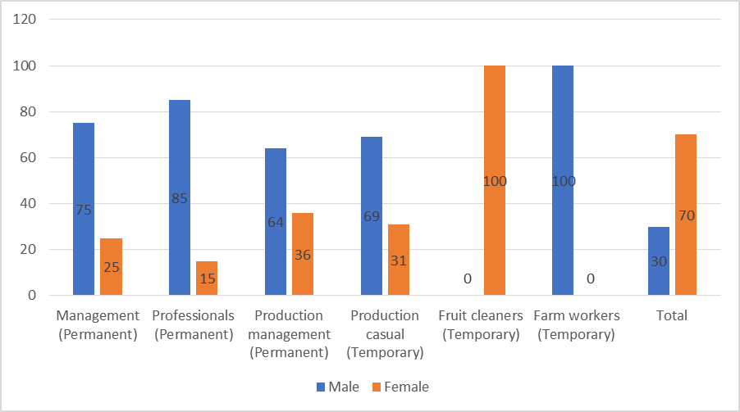
Occupation and employment types at Serendipalm
Source: Source: Serendipalm, 2017
Notes:
All in all, 82% of male employees are permanent workers while the corresponding figure for women is 16%.

Slide 49
Serendipalm Company Limited
Serendipalm is certified by Fair Trade and ECOCERT and works with a number of organisations in Ghana including The Oil Palm Research Institute (OPRI), the Food and Drugs Authority (FDA) and the Ghana Standards Authority.

Slide 50
Caltech Ventures Limited
Caltech Ventures is one of the largest cassava processing companies in the country. Its main products are used in the brewing and other industries
The company has acquired a plot of land that covers an area of 3,000 hectares for a period of 99 years. Forty percent of this land area (1,200 ha) is dedicated to the company’s nucleus while 80 ha has been given out to contract farmers
A total of 100 workers (48% of Caltech’s workers) are contract farmers
The company has engaged another group of 200 contract farmers who operate on lands that do not belong to the company
Caltech’s employment policy has shifted from one of provision of permanent employment to the casualization of labour.

Slide 51
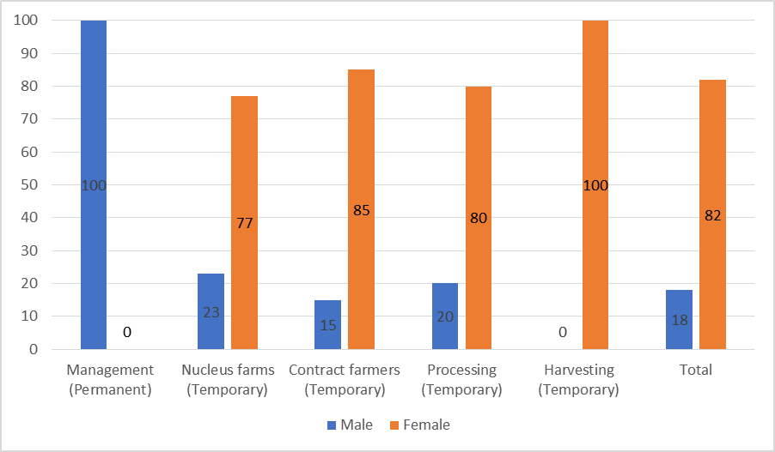
Occupation and employment types at Caltech Ventures
Source: Caltech Ventures Ltd, 2015

Slide 52
Building Businesses on Values, Integrity and Dignity (B-BOVID) Company Limited
B-BOVID is primarily concerned with palm oil and kernel processing
The company has its own nucleus, and works with 2,500 farmers. The latter comprise contract farmers, independent farmers (without contracts) and aggregators who source produce from smallholder farmers.
Only 10 percent of the company’s contract farmers are women. B-BOVID
B-BOVID has a total of 48 employees who are engaged in a range of activities at its factory – only two of these workers are women.
During the peak production period (January-July), the company hires migrant workers (predominantly women) as casual labour.

Slide 53
The regulatory regimes of contract farming schemes compared
By default, all companies in Ghana are required to operate within Ghana’s Labour Act, 2003 (Act 651).
The Act makes references to “piece workers”, “part-time workers” and “sharecroppers”, but it does this to declare that they do not fall into the categories of “temporary” or “casual workers”.
The underlying rational for regulation for all four cases is to achieve a reliable supply of quality produce
Issues of labour were pursued by the two export-oriented firms, but their prime concern was the prohibition of child labour/ preventing pregnant women from working as agricultural labour

Slide 54
The regulatory regimes of contract farming schemes compared
What has emerged in all the contract farming schemes is that most contract farmers use informal labour practices (e.g. piecework) on their farms
Communities have standard labour charges per task, charges for specific crops, etc. and this is reflected in the pay gap between men and women

Slide 55
Regulation of domestic trading…
The regulation of trade in Ghana involves three main actors: The state, local governments and traders’ associations.
The state
- The state and international development agencies have held the view that the lack of access to credit comprises a critical challenge to those who operate micro-enterprises, and participants in the informal economy in general (Egyir, 2010)
- Policy reforms in the banking and financial sector have resulted in expansion of the formal financial sector
- Among these include microfinance institutions and Rural and Community Banks which are generally viewed as institutions which cater to the needs of the poor, women, rural dwellers and those involved in agriculture and trade.

Slide 56
Regulation in domestic trading…
In 2017, a total of 34 banks, “68 Non-Bank Financial Institutions (NBFIs), 141 Rural and Community Banks (RCBs), 566 Microfinance Institutions (MFIs), 417 Forex Bureaux…were in operation” (BoG, 2017: 19).
Some authors argue that the operation of formal financial institutions, specifically MFIs, have increased access to financial services, and provided other benefits outside of the financial sphere (Egyir, 2010; Afrane & Ahiable, 2002).
The additional benefits include “enhanced public respect and acceptance, self-esteem … empowerment of women in the form of their enhanced ability to contribute to family finances, reduced dependence on their husbands, improved self-worth and confidence…” (Afrane & Ahiable 2002: 121)

Slide 57
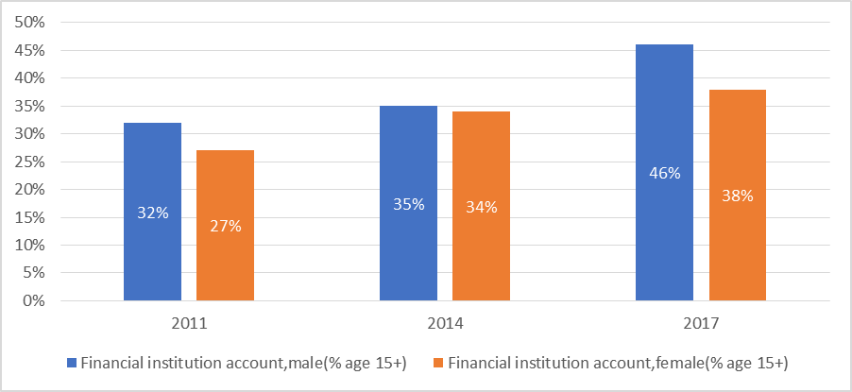
Access to a financial institution account
Source: Global Findex, 2018
Notes:
The percentage of respondents who report having an account (by themselves or together with someone else) at a bank or another type of financial institution, male (% age 15+).

Slide 58
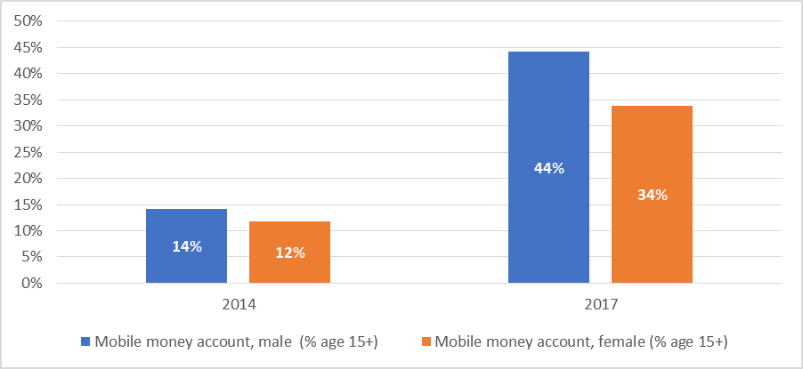
Access to a mobile money account
Source: Global Findex, 2018
Notes:
The percentage of respondents who report personally using a mobile money service in the past 12 months, male (% age 15+).

Slide 59
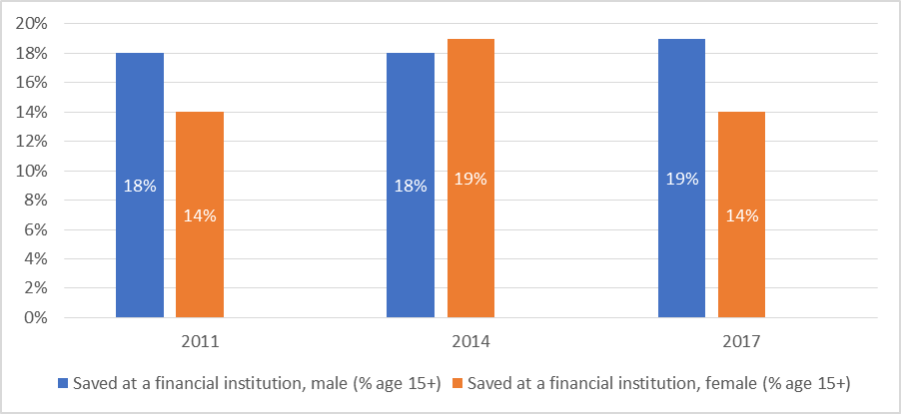
Savings at a financial institution
Source: Global Findex, 2018
Notes:
The percentage of respondents who report saving or setting aside any money at a bank or another type of financial institution in the past 12 months, male (% age 15+).

Slide 60
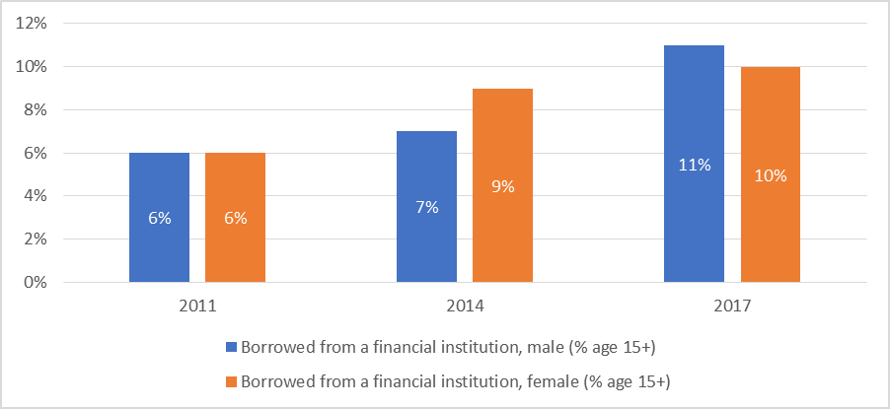
Borrowing from a financial institution
Source: Global Findex, 2018
Notes:
The percentage of respondents who report borrowing any money from a bank or another type of financial institution in the past 12 months, male (% age 15+).

Slide 61
Regulation in domestic trading…
Access to credit from a financial institution could result in “stress and distraction from family affairs” (Afrane & Ahiable 2002: 121)
Seven (7) banks which were on the verge of collapse were merged into one bank in order to secure the savings of depositors and minimise job losses (Awadzi 2018: 3).
“Of the total number of 566 licensed MFIs in 2018, 211 are active but distressed or folded up. Also, out of the total number of 141 RCBs, 37 are active but distressed or folded up. In total, it is estimated that 272 out of the 707 institutions in the sub-sector, representing 38.5% are at risk.” (BoG, 2018: 3).
Notes:
poor corporate governance practices, insider dealings, misreporting, suspicious and non-existent capital

Slide 62
Regulation in domestic trading…
Local government
- Local governments are perhaps the most crucial and “effective regulators” of trading and the informal economy in general.
- In Ghana, they are collectively referred to as districts although they are broadly categorised into metropolitan, municipal and district assemblies.
- Metropolitan (min. 250,000), Municipal (min. 95,000) and district assemblies (min. 75,000).

Slide 63
Regulation in domestic trading…
Local government
- Local governments are responsible for development and physical planning, the provision and maintenance of public infrastructure
- Extensive powers for regulating many aspects of social and economic life, particularly the use of public spaces
- They are empowered to mobilise the “resources necessary for the overall development of the district” (GoG, 2016a: 20).
- Sources of revenue: “decentralised transfers”, “internally generated funds” and “donations and grants”

Slide 64
Regulation in domestic trading…
Local government: Internally Generated Funds (IGF)
- A large share of revenue is generated from the granting of development permits, property rates, licenses, fees and taxes.
- Licenses: “Hawkers license”
- Fees: Fees are charged for the use of facilities or services provided by the district
- Taxes: income generating activities (“traders”, “cooked food sellers”)

Slide 65
Regulation in domestic trading…
Local government: Internally Generated Funds (IGF)
- Thus, trading – regardless of form – is one of the most taxed activities in many districts of Ghana
- A study of two districts found that “markets in the district capitals account for between 90% and 98% of total market revenue in both districts.” Owusu & Lund (2007)
- While fees and taxes generated from traders comprise a significant part of IGF, many traders complain about the poor state of market infrastructure (Baah-Ennumh & Adom- Asamoah, 2012; Shepherd, 2005; Owusu & Lund, 2004).

Slide 66
Conclusion
Employment policy has stressed the importance of decent work and has pointed to the need for a transition from informal to formal employment
These have not been followed up by activities that are capable of reducing the size of the labour force engaged in informal employment.
“only about 5% of Ghanaians have access to formal social security in the face of weakening traditional support systems” (NDPC, 2014: 107).

Slide 67
Conclusion
Contract farming
- Agriculture policies are more concerned with removing the obstacles to production than with conditions of work
- While women constituted a large share of workers, they were less likely than men to benefit from opportunities for permanent employment
Gender issues are not clearly articulated in the contract farming schemes
- They do not address issues of payments for overtime work and the use of family labour on farms
- Smalley, “Contract earnings are often paid to a male household head, even though they might be partly the product of women’s labour. This can unbalance the production and purchase of food within the household, especially in sub-Saharan Africa, where women tend to be responsible for buying food and men have other spending priorities” (2013: 48-49)

Slide 68
Conclusion
Domestic trading
- In domestic trading, the extension of credit to operators has been prioritised over formalisation of work although evidence about access to, and actual gains from participation in these services is inconclusive
- local governments are more concerned with generating revenue from traders through taxes although the literature point out that traders are generally dissatisfied with market and other infrastructure.

