Slide 1
Regulation of informal employment in Ghana: A review of policies, laws and practices with reference to contract farming and domestic trading
Dzodzi Tsikata and Promise Eweh
Work and well-being in the 21st Century
Observatory, Johannesburg,
5-7th April 2019

Slide 2
Introduction – context of Ghana
Context of growing informalisation of work since the 1980s
Economy largely informal to begin with, and dominated by agriculture.
Expansion of low capital, low productivity services sector
Expansion of informal work into public sector;
new forms of informality linked with growth in services- icts- telephony, food and consumer items sales; entertainment and rites of passage industry; also agro-processing and arts and crafts.
State interest in enterprise formalisation but contradictory attitude to regulation of employment.
Concerns the future of work and the well-being of work

Slide 3
The study
Focus on agriculture and trading
Importance to national and local economies
Sectors dominated by women
Efforts at regulation from different sources with different effects
Comparative potential- challenges with data availability and differences in collection/measurement methods

Slide 4
Outline of Presentation
Economic and Labour market context
Employment in Agriculture and Domestic Trading
Regulation in contract farming and domestic trading
Conclusion

Slide 5
Macro Economic and Labour Context
Population of Ghana: 29,614,337 (GSS estimate for 2018)
Size of labour force: 12,260,000 (ILO estimate for 2018)
Classification of Ghana as a lower-middle income country in 2010: GDP per capita exceeded $1,300
The discovery of oil in 2007 and its production from 2010 onwards.
Labour force participation rates very high- partly because of how employment is measured.
Unemployment rates very low-6.8%; 7% males and 6.6% females
High levels of gender segmentation of work
Women largely responsible for care work- GLSS surveys

Slide 6
Macroeconomic context
Source: World Development Indicators (WDI), 2018
Notes:
Between 2000 and 2008, GDP growth averaged 5.4%. In 2011, GDP growth was estimated at 14% and the country was declared the “fastest growing economy in Sub-Saharan Africa” (WB 2011). More importantly, the Ghana Statistical Service (GSS), upon a revision of its methods for the computation of GDP, concluded in 2010 that GDP per capita exceeded $1,300; an estimate which was far off the $750 that was expected under the old series (Jerven 2012). This resulted in the classification of Ghana as a lower- middle income country.

Slide 7
INFORMAL EMPLOYMENT IN GHANA (2000, 2010).
 | 2000 |  |  | 2010
Employment sector | Both Sexes | Male | Female | Both Sexes | Male | Female
Public | 6.4 | 8.3 | 4.5 | 6.2 | 8.1 | 4.5
Private Formal | 8.5 | 10.9 | 6.0 | 6.8 | 9.7 | 4.1
Private Informal | 83.9 | 79.1 | 88.8 | 86.2 | 81.2 | 91.0
Semi Public/Parastatal | 0.8 | 1.2 | 0.4 | 0.1 | 0.2 | 0.1
NGO(Local & International) | 0.4 | 0.5 | 0.2 | 0.5 | 0.7 | 0.3
International Organizations* | - | - | - | 0.05 | 0.1 | 0.03
Other** | 0.1 | 0.1 | 0.1 | - | - | -
All Sectors | 100 | 100 | 100 | 100 | 100 | 100
N | 7,428,374 | 3,748,887 | 3,679,487 | 10,243,447 | 5,005,522 | 5,237,925
GSS 2013: 268
Notes:
2015 Labour Force Report
“(h) Informal activity: Comprises of persons who, in the reference period, were employed in at least one informal sector enterprise, regardless of status in employment and whether it was their main or second job. Two components of informality would be measured namely:
• Employment in informal sector enterprises (Informal sector employment).
• Employment in informal jobs (Informal employment).”
“The definition of the informal employment as used in this report combines the concepts of informal production units and informal employment. Informal employment was defined as employment in an establishment where workers were not entitled to paid holidays or leave, sick or maternity leave and where there was no verbal or written contract at the time a person started to work. Any one the three conditions had to be fulfilled in order for a person to be classified as working in informal employment.” (

Slide 8
Employment status
GSS 2016, 34
Notes:
IMOW: Nearly 75% of workers are engaged in vulnerable employment. Women are more likely to be involved in vulnerable employment (80%) compared to men (65%). “Vulnerable employment is defined as the sum of the employment status groups of own- account workers and contributing family workers. They are less likely to have formal work arrangements, and are therefore more likely to lack decent working conditions, adequate social security and ‘voice’ through effective representation by trade unions and similar organizations. Vulnerable employment is often characterized by inadequate earnings, low productivity and difficult conditions of work that undermine workers’ fundamental rights.”

Slide 9
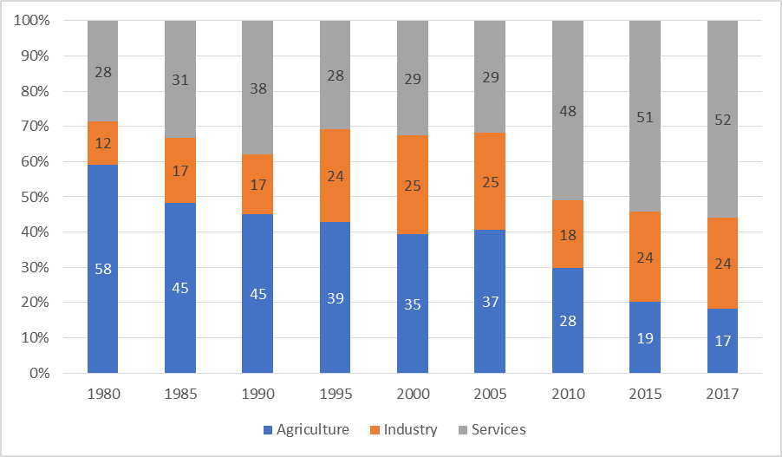
Contribution of Agriculture, Industry and Services Sectors to GDP (Ghana)
Source: World Development Indicators (WDI), 2018

Slide 10
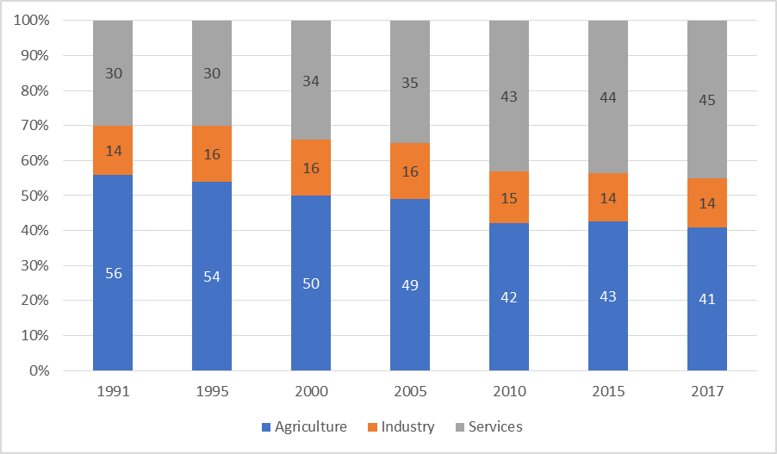
Changes in employment
Source: World Development Indicators (WDI), 2018

Slide 11
Employment in agriculture and domestic trading

Slide 12
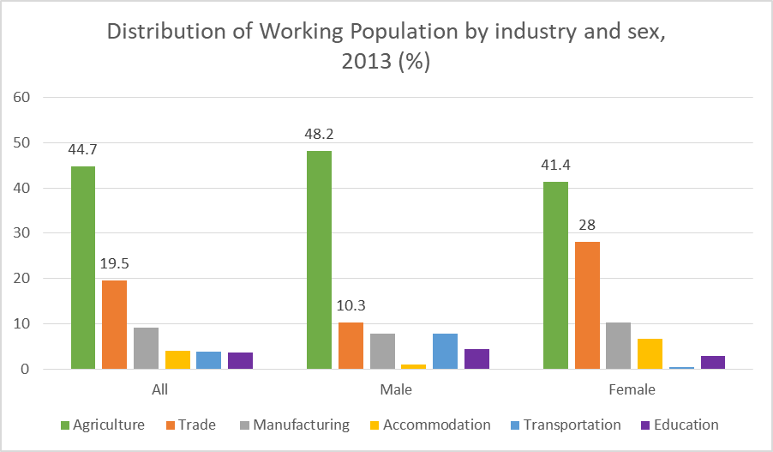
GSS 2014, 26
Notes:
Agriculture and trading combined
Total: 64%
Male: 59%
Female: 69%

Slide 13
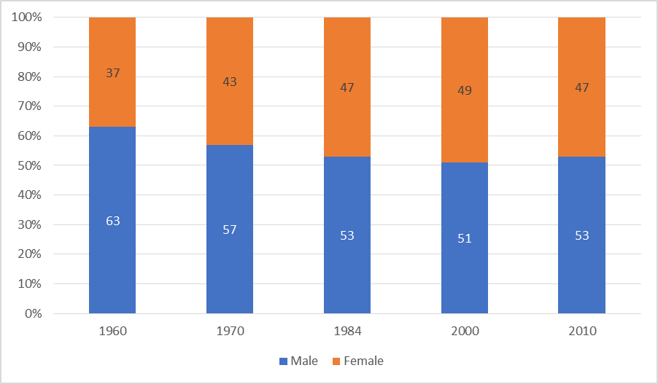
Males and females as proportion of total employed population in agriculture
GSS 2013, 2000

Slide 14
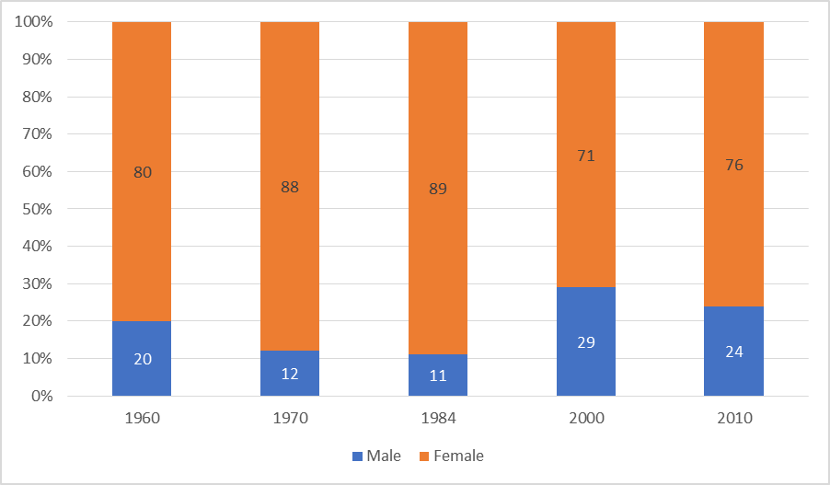
Males and females as proportion of total employed population in trading
GSS 2013, 2000

Slide 15
Informality in domestic trading and agriculture

Slide 16
Informality in domestic trading and agriculture - Whether there was a contract - Access to subsidized medical care - whether workers are entitled to social security GSS definition of informality (2015 Labour force Report)
Notes:
Data from the GLSS 6 showed that few workers in those sectors had access to a contract, written or oral, subsidized medical care and social security, thus showing very high levels of informality.

Slide 17
Occupation and Type of Contract
 | Was there a contract
Occupation | Yes, written | Yes, oral/verbal | No | Total
Armed Forces Occupations | 87 | 13 | 0 | 100.0%
Managers | 81 | 10 | 9 | 100.0%
Professionals | 84 | 7 | 9 | 100.0%
Technicians and associate professionals | 69 | 13 | 18 | 100.0%
Clerical support workers | 76 | 16 | 8 | 100.0%
Service and sales workers | 33 | 40 | 27 | 100.0%
Skilled agricultural, forestry and fishery workers | 10 | 45 | 45 | 100.0%
Craft and related trades workers | 17 | 51 | 32 | 100.0%
Plant and machine operators, and assemblers | 27 | 49 | 24 | 100.0%
Elementary occupations | 23 | 49 | 28 | 100.0%
Based on GLSS 6
Notes:
Plant and machine operators, and assemblers: Drivers and Mobile Plant Operators
Elementary occupation examples: Cleaners and helpers, food preparation assistants

Slide 18
Access to subsidized medical care
 | Entitled to subsidized medical care
Occupation | Yes | No | Total
Armed Forces Occupations | 78 | 22 | 100.0%
Managers | 50 | 50 | 100.0%
Professionals | 35 | 65 | 100.0%
Technicians and associate professionals | 48 | 52 | 100.0%
Clerical support workers | 47 | 53 | 100.0%
Service and sales workers | 18 | 82 | 100.0%
Skilled agricultural, forestry and fishery workers | 8 | 92 | 100.0%
Craft and related trades workers | 9 | 91 | 100.0%
Plant and machine operators, and assemblers | 16 | 84 | 100.0%
Elementary occupations | 16 | 84 | 100.0%
Based on GLSS 6

Slide 19
Entitled to social security
 | Entitled to any social security
Occupation | Yes | No | Total
Armed Forces Occupations | 45 | 55 | 100.0%
Managers | 72 | 28 | 100.0%
Professionals | 74 | 26 | 100.0%
Technicians and associate professionals | 55 | 45 | 100.0%
Clerical support workers | 59 | 41 | 100.0%
Service and sales workers | 26 | 74 | 100.0%
Skilled agricultural, forestry and fishery workers | 9 | 91 | 100.0%
Craft and related trades workers | 11 | 89 | 100.0%
Plant and machine operators, and assemblers | 20 | 80 | 100.0%
Elementary occupations | 19 | 81 | 100.0%
Based on GLSS 6

Slide 20
Regulation of contract farming and market trading

Slide 21
Contract farming- background
An arrangement between agribusiness firms and farmers (large, medium or small scale farmers).
The agribusiness provides farmers with credit, inputs and services (e.g. extension) in return for the right to purchase produce from producers at the end of the production season.
Variants of contract farming:
- Farmers participating in these schemes operate on their own land,
- Where the agribusiness, besides its supply of production requirements, also provides farmers with land,
- Farmers assume nearly all the risks that are associated with production: the contract is centred on the marketing of produce after harvesting.
“attractive to agribusiness- able to treat farmers as the equivalent of employees without all the social security and welfare obligations associated with employees.” Amanor (1999, 27).
“The two forms of TNC [Transnational Corporations] exploitation of low-wage labor seen in manufacturing industry—in-house and arm’s length—are also evident in agriculture” John Smith (2016: 71)
Increasing research and policy salience in land-grabbing literature- win win strategy

Slide 22
4 Cases of Contract farming
Processing for domestic and foreign market
- Blue Skies Ghana Limited
- Serendipalm Company Limited
Processing for domestic market
- Caltech Ventures Limited
- Building Businesses on Values, Integrity and Dignity
(B-BOVID) Company Limited

Slide 23
Blue Skies
Blue Skies Ghana Limited is a subsidiary of Blue Skies Holdings Ltd (UK). Subsidiaries in Brazil, Egypt, and South Africa
Processes horticultural crops (mango, pineapple, papaya and coconut) for sale on the domestic and European market
Operates two nuclei: a 1,800 acre pineapple farm and a 100 acre mango farm
It sources produce from 150 contract farmers and receives supplies from farmers in Côte d’Ivoire, Senegal and Togo
About 4,000 workers are employed during the peak production period in June – 60% of these workers are women

Slide 24
Blue Skies
Blue Skies has signed onto several initiatives and is certified by organisations including:
These initiatives are primarily concerned with food safety, production and quality standards, and in some cases labour conditions.
Notes:
“GlobalGAP standards…are primarily designed to reassure consumers about how food is produced on the farm by minimising detrimental environmental impacts of farming operations, reducing the use of chemical inputs and ensuring a responsible approach to staff health and safety” (Blue Skies, 2009: 27).
The Fairtrade certification is concerned with labour issues and it prohibits the use of children as labour.

Slide 25
Serendipalm Company Limited
Prime business is the processing and sourcing of organic oil palm
Main buyers: Dr. Bronners (a producer of natural soaps in the United States), and Rapunzel and GEPA (two manufacturers of food products in Germany)
Engages 645 contract farmers: 44% are women
Farmers are smallholders dependent primarily on family labour although employ hired labour occasionally.
Farmers prohibited from engaging the services of children and pregnant women
In addition to contract farmers, Serendipalm has a total of 257 employees engaged in a range of activities.
certified by Fair Trade and ECOCERT and works with a number of organisations in Ghana including The Oil Palm Research Institute (OPRI), the Food and Drugs Authority (FDA) and the Ghana Standards Authority.

Slide 26
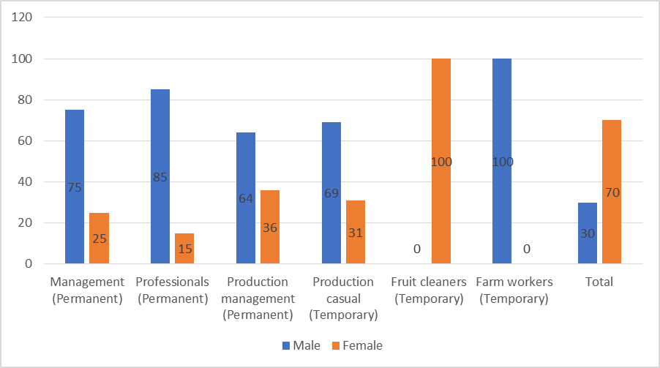
Occupation and employment types at Serendipalm
Source: Source: Serendipalm, 2017
Notes:
All in all, 82% of male employees are permanent workers while the corresponding figure for women is 16%.

Slide 27
The regulatory regimes of contract farming schemes
By default, all companies in Ghana are required to operate within Ghana’s Labour Act, 2003 (Act 651).
The Act makes references to “piece workers”, “part-time workers” and “sharecroppers”, but it does this to declare that they do not fall into the categories of “temporary” or “casual workers”.
Notes:
“Temporary worker 75. (1) a temporary worker who is employed by the same employer for a continuous period of six months and more shall be treated under this Part as a permanent worker.”
“Workers paid per task they perform or piece of work they do (known as piece work) are classed as doing ‘output work’.”
“Casual worker 74. (1) A contract of employment of a casual worker need not be in writing.”

Slide 28
The regulatory regimes of contract farming schemes compared
The underlying rationale for regulation for all four cases is to achieve a reliable supply of quality produce
Issues of labour were pursued by the two export-oriented firms, but their prime concern was the prohibition of child labour/ preventing pregnant women from working as agricultural labour
What has emerged in all the contract farming schemes is that most contract farmers use informal labour practices (e.g. piecework) on their farms
Communities have standard labour charges per task, charges for specific crops, etc. and this is reflected in the pay gap between men and women

Slide 29
Regulation of domestic trading
The regulation of trade in Ghana involves three main actors: The state, local governments and traders’ associations.
The state
- The state and international development agencies have held the view that the lack of access to credit comprises a critical challenge to those who operate micro-enterprises, and participants in the informal economy in general (Egyir, 2010)
- Reforms in the banking and financial sector have resulted in expansion of the formal financial sector
- Microfinance institutions and Rural and Community Banks which are generally viewed as institutions which cater to the needs of the poor, women, rural dwellers and those involved in agriculture and trade.
Notes:
“The government in 1983 started implementing a Structural Adjustment Facility from the International Monetary Fund (IMF) to reform key sectors of the economy. By 1986 it was widely accepted that reforms were needed to encourage the development of the financial sector in order to deepen financial intermediation and create new investment instruments, as well as encourage the establishment of new financial institutions that would all go to make the economy much more competitive in the world economy.”

Slide 30
Local government regulatory approaches
Local government
- Local governments are responsible for development and physical planning, the provision and maintenance of public infrastructure
- Extensive powers for regulating many aspects of social and economic life, particularly the use of public spaces
- They are empowered to mobilise the “resources necessary for the overall development of the district” (GoG, 2016a: 20).
- Sources of revenue: “decentralised transfers”, “internally generated funds” and “donations and grants”
Notes:
Local governments are perhaps the most crucial of the regulators of trading
In a study in which traders were asked to identify and rank actors whose activities had an influence on trading, local government bodies “received the highest mentions on aggregate, indicating that these loomed large in the everyday lives of vendors” (Anyidoho & Steel 2016, 13). In
- In Ghana, they are collectively referred to as districts although they are broadly categorised into metropolitan, municipal and district assemblies.
- Metropolitan (min. 250,000), Municipal (min. 95,000) and district assemblies (min. 75,000).

Slide 31
Local government regulatory approaches
Local government: Internally Generated Funds (IGF)
- granting of development permits, property rates, licenses, fees and taxes.
- Licenses: “Hawkers license”
- Fees: Fees are charged for the use of facilities or services provided by the district
- Taxes: income generating activities (“traders”, “cooked food sellers”)

Slide 32
Local government regulatory approaches
Local government: Internally Generated Funds (IGF)
- Thus, trading – regardless of form – is one of the most taxed activities in many districts of Ghana
- A study of two districts found that “markets in the district capitals account for between 90% and 98% of total market revenue in both districts.” Owusu & Lund (2007)
- While fees and taxes generated from traders comprise a significant part of IGF, many traders complain about the poor state of market infrastructure

Slide 33
Local government regulatory approaches
Local government: Forced evictions and decongestion exercises
- Street vendors prefer to operate on streets and pavements in and around the central business districts, etc.
- This creates competition and conflict between street vendors and other users of public spaces, particularly pedestrians.
- Local governments in Ghana are often judged in terms of their ability to deal with traffic management, congestion, sanitation and waste management
Notes:
The measures are sometimes implemented in pursuit of some national goal of ‘modernisation’, or “formalizing the use of public spaces” (Steel et al. 2014, 2).

Slide 34
Local government regulatory approaches
Local government: Forced evictions and decongestion exercises
- Selling on streets and pavements is outlawed by the Accra Metropolitan Assembly
- Evictions and decongestion carried out in pursuit of some national goal of ‘modernisation’, or “formalizing the use of public spaces” (Steel et al. 2014, 2).
- Relocations and their impacts (Odawna Pedestrian Market)
- Segmentation of domestic trading (street vendors)
Notes:
Anyidoho & Steel 2016: “Specifically, women make up 88 per cent of street traders (Budlender 2011).”

Slide 35
Practices of traders associations
Using their representation in district assemblies and legal procedures to challenge decisions
Interacting with district officials about the rehabilitation or construction of new markets
Organisation of trade, and attending to the livelihoods and welfare needs of their members
- Facilitating the extension of credit to members
- Supporting members in performing social obligations such as wakes and burials
Rotating savings and credit associations (ROSCA).
Notes:
In some cases, association representatives may even take advantage of their relationships with politicians in the national government to steer the decisions of local governments in their favour. Interestingly, Bob-Milliar & Obeng-Odoom (2011, 273-6) argue that decongestion and forced evictions have political dimensions. Crucially, they even claim that the President of Ghana at one point intervened to prevent the planned decongestion of one informal settlement in Accra which was believed to be sympathetic to the governing party while allowing similar actions to occur in another settlement which was perceived to be more loyal to the opposition.

Slide 36
Practices of traders associations
Using their representation in district assemblies and legal procedures to challenge decisions
Interacting with district officials about the rehabilitation or construction of new markets
Organisation of trade, and attending to the livelihoods and welfare needs of their members
- Facilitating the extension of credit to members
- Supporting members in performing social obligations such as wakes and burials
Rotating savings and credit associations (ROSCA).
Notes:
In some cases, association representatives may even take advantage of their relationships with politicians in the national government to steer the decisions of local governments in their favour. Interestingly, Bob-Milliar & Obeng-Odoom (2011, 273-6) argue that decongestion and forced evictions have political dimensions. Crucially, they even claim that the President of Ghana at one point intervened to prevent the planned decongestion of one informal settlement in Accra which was believed to be sympathetic to the governing party while allowing similar actions to occur in another settlement which was perceived to be more loyal to the opposition.

Slide 37
Conclusions: Do these regulations and practices constitute formalisation?
Traders
The state seeks to improve access to credit, and enhance entrepreneurship and skills development for domestic traders
Informal banking and insurance arrangements continue to be sustainable and are sometimes more reliable sources for traders
Local governments are more hostile to street vendors where poor traders and women dominate: demolitions and forced evictions are only successful in temporarily disrupting the activities and incomes of street vendors
Regulation of domestic trading has little to do with the formalisation of work.
Employment policy has stressed the importance of decent work and has pointed to the need for a transition from informal to formal employment
These have not been followed up by activities that are capable of reducing the size of the labour force engaged in informal employment.

Slide 38
Conclusion
Contract farming
- Agriculture policies are more concerned with removing the obstacles to production than with conditions of work
- While women constituted a larger share of contract workers, they were less likely than men to benefit from opportunities for permanent employment within the nucleus farms.
Gender issues are not clearly articulated in the contract farming schemes
- They do not address issues of payments for overtime work and the use of family labour on farms

