Slide 1
What formalisation promises and delivers: women in contract farming in Ghana.
Dzodzi Tsikata and Promise Eweh
IAFFE 2019
27/06/2019

Slide 2
Introduction – Ghana
Economy dominated by agriculture;
Largely informal since colonisation; expected to become formalised as a result of economic growth and modernisation.
Formalisation thesis debunked.
Acceleration of informalisation of work since the 1980s
Expansion of low capital, low productivity services sector
Expansion of informal work into public sector;
New forms of informality linked with growth in services- icts- telephony, food and consumer items sales; entertainment and rites of passage industry; also agro-processing and arts and crafts.
State interest in enterprise formalisation but contradictory attitude to regulation of employment.

Slide 3
The presentation
Focus on agriculture
Importance to national and local economies; dominated by women
Efforts at regulation from different sources with different effects
Outline
Economic and Labour market context
Employment in Agriculture
Regulation in contract farming and domestic trading
Conclusion

Slide 4
Macro Economic and Labour Context
Population of Ghana: 29,614,337 (GSS estimate for 2018)
Size of labour force: 12,260,000 (ILO estimate for 2018)
Classification of Ghana as a lower-middle income country in 2010: GDP per capita exceeded $1,300
Labour force participation rates very high- partly because of how employment is measured.
Unemployment rates very low-6.8%; 7% males and 6.6% females
High levels of gender segmentation of work
Women largely responsible for care work- GLSS surveys

Slide 5
INFORMAL EMPLOYMENT IN GHANA (2000, 2010).
 | 2000 |  |  | 2010
Employment sector | Both Sexes | Male | Female | Both Sexes | Male | Female
Public | 6.4 | 8.3 | 4.5 | 6.2 | 8.1 | 4.5
Private Formal | 8.5 | 10.9 | 6.0 | 6.8 | 9.7 | 4.1
Private Informal | 83.9 | 79.1 | 88.8 | 86.2 | 81.2 | 91.0
Semi Public/Parastatal | 0.8 | 1.2 | 0.4 | 0.1 | 0.2 | 0.1
NGO(Local & International) | 0.4 | 0.5 | 0.2 | 0.5 | 0.7 | 0.3
International Organizations* | - | - | - | 0.05 | 0.1 | 0.03
Other** | 0.1 | 0.1 | 0.1 | - | - | -
All Sectors | 100 | 100 | 100 | 100 | 100 | 100
N | 7,428,374 | 3,748,887 | 3,679,487 | 10,243,447 | 5,005,522 | 5,237,925
GSS 2013: 268
Notes:
2015 Labour Force Report
“(h) Informal activity: Comprises of persons who, in the reference period, were employed in at least one informal sector enterprise, regardless of status in employment and whether it was their main or second job. Two components of informality would be measured namely:
• Employment in informal sector enterprises (Informal sector employment).
• Employment in informal jobs (Informal employment).”
“The definition of the informal employment as used in this report combines the concepts of informal production units and informal employment. Informal employment was defined as employment in an establishment where workers were not entitled to paid holidays or leave, sick or maternity leave and where there was no verbal or written contract at the time a person started to work. Any one the three conditions had to be fulfilled in order for a person to be classified as working in informal employment.” (

Slide 6
Employment status
GSS 2016, 34
Notes:
IMOW: Nearly 75% of workers are engaged in vulnerable employment. Women are more likely to be involved in vulnerable employment (80%) compared to men (65%). “Vulnerable employment is defined as the sum of the employment status groups of own- account workers and contributing family workers. They are less likely to have formal work arrangements, and are therefore more likely to lack decent working conditions, adequate social security and ‘voice’ through effective representation by trade unions and similar organizations. Vulnerable employment is often characterized by inadequate earnings, low productivity and difficult conditions of work that undermine workers’ fundamental rights.”

Slide 7
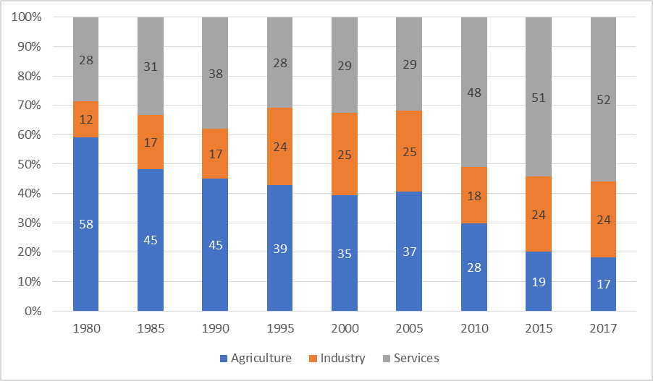
Contribution of Agriculture, Industry and Services Sectors to GDP (Ghana)
Source: World Development Indicators (WDI), 2018

Slide 8
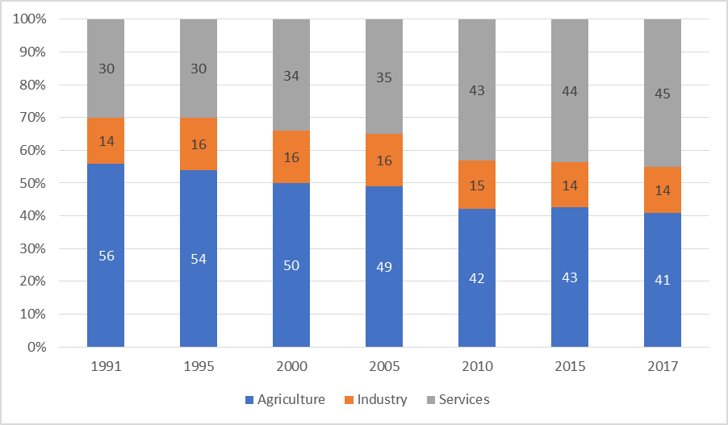
Changes in employment
Source: World Development Indicators (WDI), 2018

Slide 9
Employment in agriculture

Slide 10
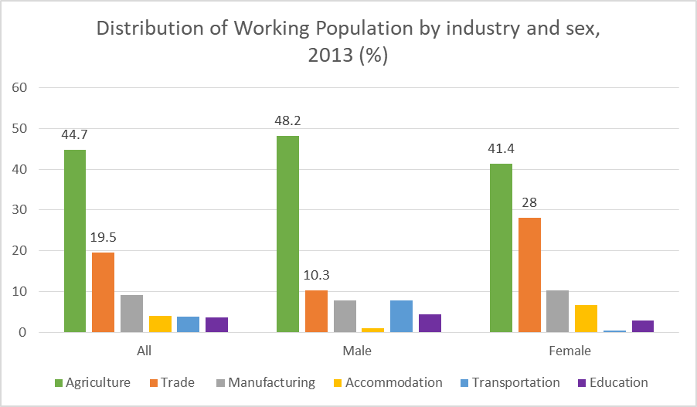
GSS 2014, 26
Notes:
Agriculture and trading combined
Total: 64%
Male: 59%
Female: 69%

Slide 11
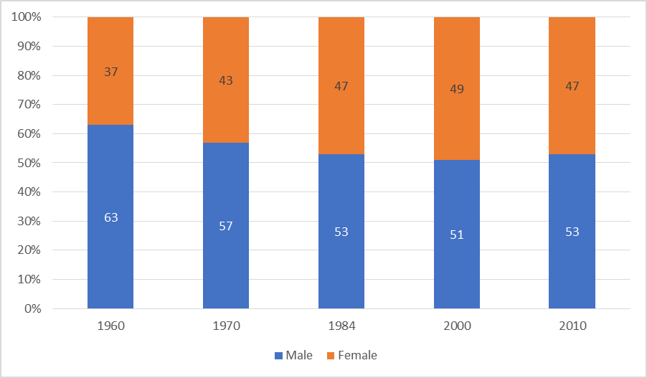
Males and females as proportion of total employed population in agriculture
GSS 2013, 2000

Slide 12
Informality in agriculture

Slide 13
Informality in agriculture - Whether there was a contract - Access to subsidized medical care - whether workers are entitled to social security GSS definition of informality (2015 Labour force Report)
Notes:
Data from the GLSS 6 showed that few workers in those sectors had access to a contract, written or oral, subsidized medical care and social security, thus showing very high levels of informality.

Slide 14
Occupation and Type of Contract
 | Was there a contract
Occupation | Yes, written | Yes, oral/verbal | No | Total
Armed Forces Occupations | 87 | 13 | 0 | 100.0%
Managers | 81 | 10 | 9 | 100.0%
Professionals | 84 | 7 | 9 | 100.0%
Technicians and associate professionals | 69 | 13 | 18 | 100.0%
Clerical support workers | 76 | 16 | 8 | 100.0%
Service and sales workers | 33 | 40 | 27 | 100.0%
Skilled agricultural, forestry and fishery workers | 10 | 45 | 45 | 100.0%
Craft and related trades workers | 17 | 51 | 32 | 100.0%
Plant and machine operators, and assemblers | 27 | 49 | 24 | 100.0%
Elementary occupations | 23 | 49 | 28 | 100.0%
Based on GLSS 6
Notes:
Plant and machine operators, and assemblers: Drivers and Mobile Plant Operators
Elementary occupation examples: Cleaners and helpers, food preparation assistants

Slide 15
Access to subsidized medical care
 | Entitled to subsidized medical care
Occupation | Yes | No | Total
Armed Forces Occupations | 78 | 22 | 100.0%
Managers | 50 | 50 | 100.0%
Professionals | 35 | 65 | 100.0%
Technicians and associate professionals | 48 | 52 | 100.0%
Clerical support workers | 47 | 53 | 100.0%
Service and sales workers | 18 | 82 | 100.0%
Skilled agricultural, forestry and fishery workers | 8 | 92 | 100.0%
Craft and related trades workers | 9 | 91 | 100.0%
Plant and machine operators, and assemblers | 16 | 84 | 100.0%
Elementary occupations | 16 | 84 | 100.0%
Based on GLSS 6

Slide 16
Entitled to social security
 | Entitled to any social security
Occupation | Yes | No | Total
Armed Forces Occupations | 45 | 55 | 100.0%
Managers | 72 | 28 | 100.0%
Professionals | 74 | 26 | 100.0%
Technicians and associate professionals | 55 | 45 | 100.0%
Clerical support workers | 59 | 41 | 100.0%
Service and sales workers | 26 | 74 | 100.0%
Skilled agricultural, forestry and fishery workers | 9 | 91 | 100.0%
Craft and related trades workers | 11 | 89 | 100.0%
Plant and machine operators, and assemblers | 20 | 80 | 100.0%
Elementary occupations | 19 | 81 | 100.0%
Based on GLSS 6

Slide 17
Features of Agriculture in Ghana
Long history of commercialisation; low investment base- rubber, oil palm, cocoa, food crops, horticulture; biofuels;
Also small ruminants and fishing
Mainly small holder- less than 2ha (82% of the total amount of farming land).
HH production; basic technologies- Animal traction in most areas, little mechanized farming.
Produce 80% of Ghana’s total agriculture output
Agrarian stagnation- (3.6% annual growth instead of 6%)
Failure of agrarian transformation
Three models of agricultural commercialisation
Estates and Plantations; Contract farming; Small and Medium size commercial farms
Increasing research and policy salience in land-grabbing literature- win win strategy

Slide 18
Contract farming- background
An arrangement between agribusiness firms and farmers (large, medium or small scale farmers).
The agribusiness provides farmers with credit, inputs and services (e.g. extension) in return for the right to purchase produce from producers.
Variants of contract farming:
- Farmers operate on their own land with inputs and extension from agribusiness
- Where the agribusiness supplies both land and inputs
-Where farmers provide own land and inputs and contract is centred on marketing.
“attractive to agribusiness- able to treat farmers as the equivalent of employees without all the social security and welfare obligations associated with employees.” Amanor (1999, 27).
“The two forms of TNC [Transnational Corporations] exploitation of low-wage labour seen in manufacturing industry—in-house and arm’s length—are also evident in agriculture” John Smith (2016: 71)

Slide 19
The regulatory regimes of contract farming schemes
All enterprises in Ghana are required to operate within Ghana’s Labour Act, 2003 (Act 651).
The Act makes references to “piece workers”, “part-time workers” and “sharecroppers”, but it does this to declare that they do not fall into the categories of “temporary” or “casual workers” whose status changes to permanent workers after continuous employment of six months.
The underlying rationale for regulation is to achieve a reliable supply of quality produce and fair trade certification- voluntary codes;
Issues of labour pursued by export-oriented firms, but mainly re: child labour and pregnant women (standards and certifications)
Most contract farmers use informal labour practices (e.g. piecework; family labour) on their farms
Communities have standard labour charges per task, charges for specific crops, etc. and this is reflected in the pay gap between men and women
Notes:
“Temporary worker 75. (1) a temporary worker who is employed by the same employer for a continuous period of six months and more shall be treated under this Part as a permanent worker.”
“Workers paid per task they perform or piece of work they do (known as piece work) are classed as doing ‘output work’.”
“Casual worker 74. (1) A contract of employment of a casual worker need not be in writing.”

Slide 20
Conclusion
Contract farming
- Agriculture policies are more concerned with removing the obstacles to production than with conditions of work
- While women constituted a larger share of contract workers, they were less likely than men to benefit from opportunities for permanent employment within the nucleus farms.
Gender issues are not clearly articulated in the contract farming schemes
- There are no arrangements for payments for overtime work and the use of family labour on farms

