Slide 1
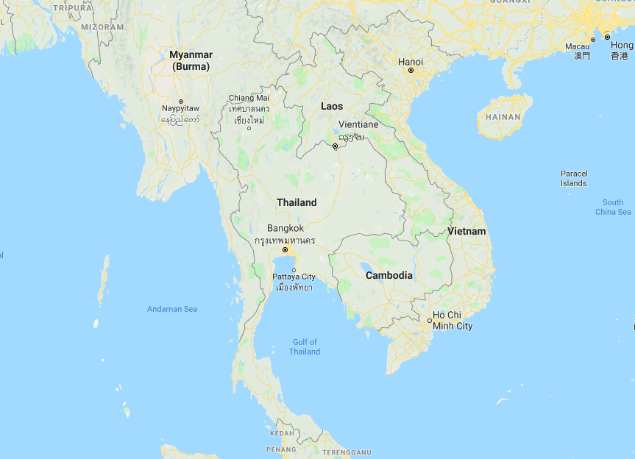
Formalizing the Informal Economy: A Gender Perspective - Thailand -
Sorravich Kingsuwankul, Warn Nuarpear Lekfuangfu, Worralak Pakampai, Peera Tangtammaruk,
Jessica Vechbanyongratana, and Yong Yoon

Slide 2
Thailand Overview
Rapid economic development:
Transformed from agricultural to manufacturing/service based economy since 1980s
Expansion of compulsory and free education since the 1970s
Middle-income country (per capita income $7,000 or $19,000 ppp)
Current labor statistics:
Population of 68 million; 38 million people in the labor force
Labor force participation rates (age 15+)
Men = 76%
Women = 60%
Unemployment rate = 1%
Despite this, Thailand’s labor market is largely informal!

Slide 3
Formalizing Labor Laws and Regulations
Labour Protection Act B.E. 2541 (1998)
Social Security Act, B.E. 2533 (1990)
Section 33 – Employer provided social security by law
Section 39 – Voluntary scheme for those who left employment covered by Section 33
Section 40 – Voluntary scheme for informally and self-employed
Other
Prompt-Pay for cashless transactions targeted at informal vendors who are predominantly female

Slide 4
Thai Government’s Definition of Formal Employment
All civil servants
All state enterprises employees
Private school principals or teachers, according to the law governing private schools.
Employees who have protection under Labour Legislation
Workers who are insured according to Social Security Act B.E. 2533 (1990), Sections: 33, 39, 40

Slide 5
Social Protection in the Informal Economy
Universal Healthcare (UCS or “30 baht” healthcare) – provides comprehensive health coverage for a nominal charge.
Universal Non-contributory Old-age Pension (Bt 600-1000 per month)
“Poor Card” – cash card used to purchase necessities and transportation
Free education up to age 17
Optional Social Security (Section 40)
Pension
Invalidity
Death
Child payment

Slide 6
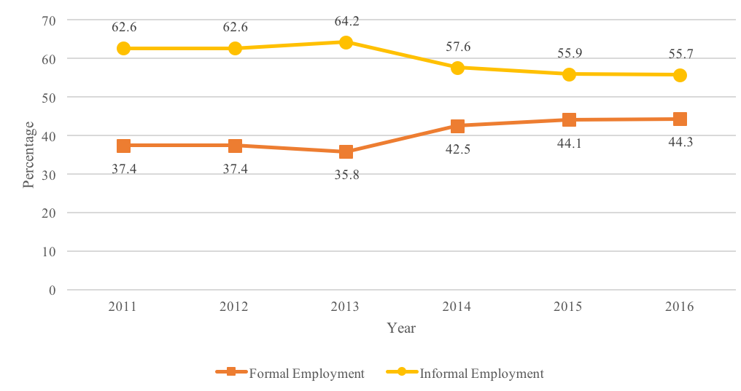
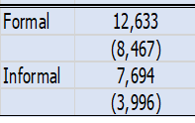
Incidence of Informality, 2011-2016 & Mean monthly earning 2016 (Baht)

Slide 7
Male-Female Wage Gap (All Workers Earning Labor Income)

Slide 8
Formal vs. Informal Gender Wage Gap

Slide 9
Formal and Informal Monthly Labor Earnings (Private Firms)

Slide 10
Three Case Studies
Domestic Workers
Manufacturing
Sex Work

Slide 11
Domestic Work
Domestic cleaners and helpers working in homes
 | Formal | Informal
Hours Worked per Week | 44.5 | 50.0
Monthly Labor Income | 8,330 | 8,354
Hourly Wage | 46 | 41
Cleaners and helpers working in offices and hotels
 | Formal | Informal
Hours Worked per Week | 46.8 | 45.3
Monthly Labor Income | 9,013 | 7,513
Hourly Wage | 49 | 42
Minimum Wage = 37.5 baht per hour
Source: Labor Force Surveys, 2011-16

Slide 12
Domestic Work
Why do women choose to work in informal settings when formal cleaning work is available?
Even though work hours are long, employers provide flexibility to take care of personal business and give annual leave/sick leave.
Tasks are easier and there is less pressure.
Access to informal credit through employer
No transportation or living costs (for live-in workers)

Slide 13
Sex Work
Sex industry in Thailand (2015) is estimated to be worth US$6.4 billion a year in revenue, accounting for 3% of GDP
Caters to both international tourists and domestic persons
Sex Workers
Workers in Bangkok predominantly from North and Northeastern Thailand
Workers in the provinces predominantly come from neighbouring countries.
Prevention and Suppression of Prostitution Act 2539 (1996) and Article 286 of the Criminal Code make selling sex illegal (but not buying sex) in Thailand.

Slide 14
Sex Work
Sex workers can be classified as “venue-based” sex workers, meaning they work in massage parlors, spas, and other entertainment venues and/or “non-venue based” sex workers
Establishments are legally registered businesses → sex workers (a.k.a. “service providers”) are covered by social security and are considered formal.
It is common policy to have sex worker undergo health tests (incl. HIV) every 3 months.
Technically covered by Labour Law
Access to national health coverage
But, given that selling sex is illegal, workers often cannot access the Labour Law because of risk of prosecution.
Vulnerable to harassment and sexual abuse by employers and customers.

Slide 15
Conclusions
Thailand has high demand for (female) workers for (lower) skilled work in the formal sector, but many choose to work in the informal sector
Flexibility (esp. to tackle family responsibilities)
Less pressure at work place
Social networks
Already have access to social protection
Blanket formalization policies is not suitable
Do not take into consideration preferences for informal working environment that are more compatible with (female) caring roles
In sex industry, social stigma may actually drive some activities further underground if legalized

