Slide 1
Women workers and the quest for formalisation The Indian experience
IDEAs Panel on Gender Implications of Formalisation Policies
Glasgow, 27 June 2019

Slide 2
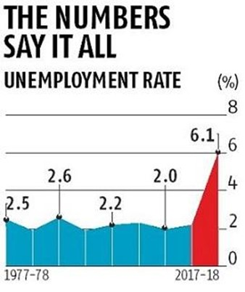
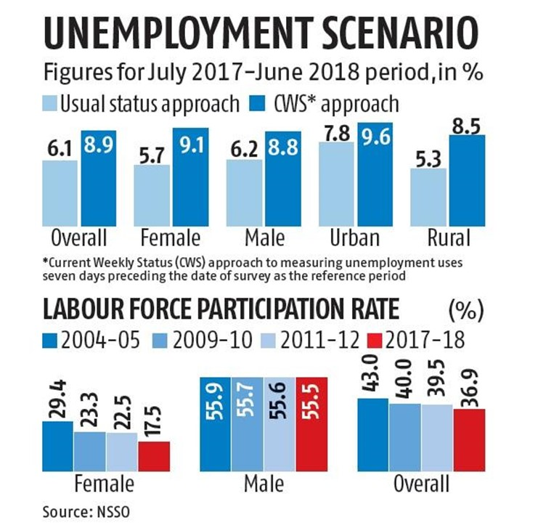
Huge slack in the Indian labour market Recent absolute declines in employment, after low employment growth during boom

Slide 3
Big decline in women’s employment, especially in rural areas

Slide 4
Employment in India is overwhelmingly informal, even in organised sectors
Distribution of Employment
 | Public |  | Private
 | Informal | Formal | Informal | Formal
2004-05
Unorganised | 12.3 | 87.7 | 94.5 | 5.5
Organised | 6.6 | 93.4 | 56.5 | 43.5
Total | 9.7 | 90.3 | 90.8 | 9.16
2011-12
Unorganised | 25.6 | 74.4 | 94.5 | 5.5
Organised | 23 | 77 | 54.3 | 45.7
Total | 24.3 | 75.7 | 88.7 | 11.3

Slide 5
In 2017-18, most workers still had few advantages of formal contracts – and women workers were generally worse off than men

Slide 6
Recent policy attempts at formalisation
Of workers:
Unorganised Workers Social Security Act 2008
Maternity Benefits Act (1961), Amendment 2017
Pradhan Mantri MUDRA Yojana
National Urban Livelihoods Mission
Stand Up India
Street Vendors (Protection of Livelihood and Regulations of Street Vending) Act, 2014
Employees’ Provident Fund
Of enterprises:
Demonetisation and digitisation
Goods and Services Tax

Slide 7
The viability of informal activities is being hit by new policies, but the formal sector is simply not generating enough employment to make up
Problems in agriculture and the viability of farming
Demonetisation and attempt to force digital transactions that involve costs
A common system of Goods and Services Tax rolled out as of 1 July 2017
Very complicated – 8 different rates
Adds to accounting costs of micro and small enterprises. Affects companies operating on very low margins and force shift to larger companies

Slide 8
Primary survey in Delhi NCR

Slide 9
Nature of respondents
Age: 40% 18-30 years, 31% 31-40 years, 17% 41-50 years, 12% 50+ years.
Education: More than 50% of interviewed women workers were not literate; less than 25% had higher education. 13% of men were not literate; 33% had higher education.
More than 75% of interviewed workers were married: 79% of women and 73 % of men.
85% of the workers were migrants, mostly from North, East and Central states. Men workers migrated primarily for employment, women workers for marriage and then employment.

Slide 10
No relation between formalisation of enterprise and formalisation of work
Higher percentage of men workers (73%) were employed at registered enterprise as compared to women (40%)
But more than 50% of casual workers were working in registered enterprises, so work in the formal sector did not ensure formal employment conditions.
Even in formal enterprises, basic laws like minimum wage laws did not apply.

Slide 11
Violation of minimum wages laws in the formal sector
In registered enterprises, 50% of the women and 45% of the men workers were earning less than minimum wages.
This was true of casual workers (more than 70% of women and 33 of men) and regular workers (more than 60%)
The difference was sometimes as much as half the minimum wage!
Percentage of workers in the registered enterprise earning below minimum wages
 | Occupation | Percentage
Female | Casual Labour | 77.8
 | Regular/ Salaried | 62.5
 | Self Employed | 20
 | Total | 50
Male | Casual Labour | 33.3
 | Regular/ Salaried | 62.5
 | Self Employed | 42.9
 | Selfemployed: homebased | 33.3
 | Total | 45.5

Slide 12
Lack of social security
Only 12% of women and 17% of men workers got any social security provisions from employers.
Casual workers and home based workers were the most vulnerable in terms of lack of social security.
More men workers (20%) had access to private social security than women (9%)
Only 5% of the workers (all women) got some social security benefits from government sources.
There was significant lack of awareness of rights and entitlements of social security, and many did not know that they would receive some provident fund benefits after contributions – they thought it was must another tax.

Slide 13
Paid leave and written contracts
Of the regular workers, only 56% of women and 50% of men had four days of paid leave in a month.
Only 43% of the women and 50% of the men regular workers had written contracts.
None of the casual workers (men or women), home based workers and recently unemployed (in their previous employment) had written contracts.

Slide 14
Union participation
Of the 120 workers interviewed only 18 workers (15 per cent) were a part of a union, 16 women and 2 men.
Of these 18 workers, 12 were street vendors, 5 were regular/salaried workers and 1 was a casual worker.
The home-based workers interviewed didn’t have any union/association, despite working in the same locality.
The workers associated with a union were found to be more empowered, but they were in minority even in regular/salaried work.

Slide 15
Labour market fluidity
Movement of daily wagers in and out of regular employment among factory workers in Kapashera area.
All surveyed workers had at some point been fired without notice and lost access to social security benefits provided by the previous employer.
These workers then entered the group of daily wagers, looking for work on a daily basis, without access to the wages, social security or benefits they had earlier enjoyed.
Woman migrant who came to Delhi 3 years ago, in 2018 was casual worker in Jan-Feb, then regular work as a security guard Apr-June; had to return to village for personal reasons in July so lost that job, now seeking casual work.
Woman salesperson at a leading Indian supermarket chain, employed by different brands active at the supermarket. So same workplace and conditions, but wages and social security benefits varied according to the brands (which changed over months, weeks or even days).

Slide 16
Overtime Wages
Workers are entitled to double wages for their over time work. But only 20% of men workers and 15% of women workers got any overtime pay, and most got only the regular wage rather than double the rate.
7% of men and 11% of women worked overtime without any additional payment.
18% of workers did not work overtime, while a small minority (less than 2%) who were willing to work overtime were not given such opportunities.
Self-employed workers tended to work long hours well beyond the stipulated work week

Slide 17
Conclusions - 1
Most official measures designed to increase formalisation of the Indian workforce have essentially failed.
Macroeconomic measures like demonetisation have affected viability of informal activities.
Many government schemes to provide some “formal sector-type” benefits to workers such as pensions are merely limited substitutes for formalisation, but these are often mistakenly identified as evidence of formalisation.
Trying to formalise enterprises rather than workers can be detrimental to workers, negatively affecting their livelihood and employment. E.g. demonetisation and GST.

Slide 18
Conclusions - 2
Measures of formalisation (such as paid leave or social security or written contract) inadequate to measure decent work, since even workers with one or more of these indicators face extreme insecurity of tenure and exploitation.
“Fake formalisation”, when either informal enterprises get subsumed in formal enterprises or workers are classified as “formal” without really getting any associated protection/benefits
Labour market fluidity leads to the movement of workers across unorganised/organised sectors with only transient benefits, without real changes in their basic situation and conditions.

Slide 19
Conclusions - 3
Women workers are often the worst affected by formalisation measures because of the gender blindness of many measures.
Even well-meaning measures to improve conditions of working women (such as maternity benefit laws) can operate against their interests in some contexts.
Lack of awareness of many laws and schemes, and difficulty of accessing entitlements, still operate against the interests of informal workers, and especially women.
Public employment can set a positive trend or make a bad situation worse (“voluntary workers”).
Association, mobilisation and unionisation can be crucial in affecting awareness and demands for rights.

